Slide 1
THG Simulations
Project update: follow-up
Week 3B
11/08/2023
David Amorim

Slide 2
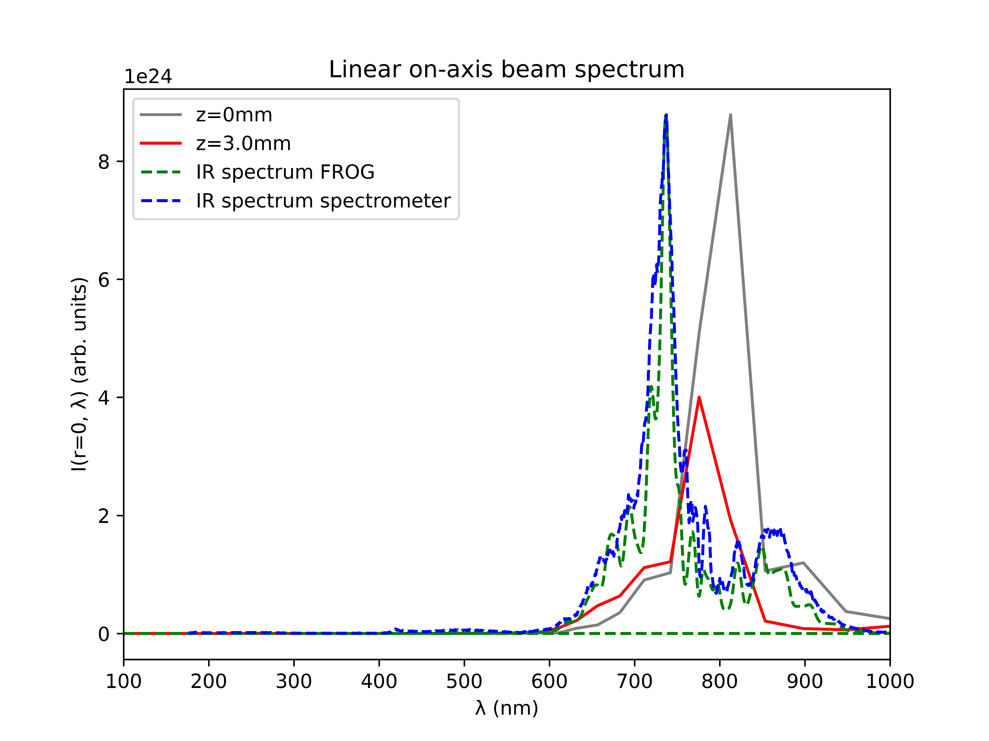
Comparison of spectra
IR spectrum calculated from FROG largely agrees with IR spectrum measured by spectrometer
The shape of the spectra also agree with the simulated IR spectrum (grey)
However, the measured spectra are centred around 730nm, not 800nm
Set the central wavelength to 730nm in the simulations?

Slide 3
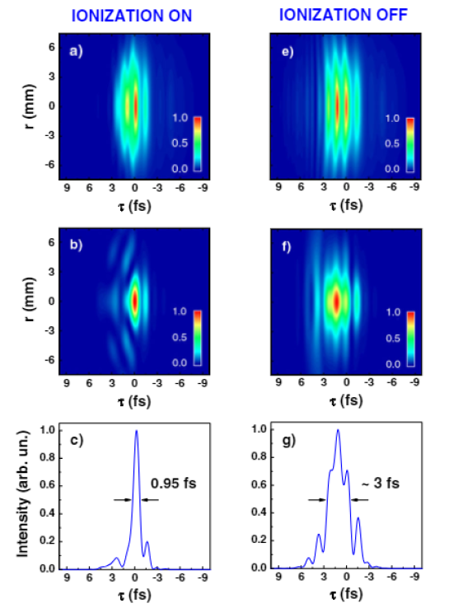
Reproducing plots from Reiter et al. 2010
In Reiter: spatiotemporal evolution shows leading-edge self-steepening in UV and trailing-edge in IR
In Reiter: removing ionisation suppresses self-steepening and elongates pulse
Parameters: 300μJ IR pulse centred on 750nm incident on Neon cell with 9.0bar central pressure
This system was simulated, comparing the ionised and non-ionised case
IR
UV
UV
Reiter 2010

Slide 4
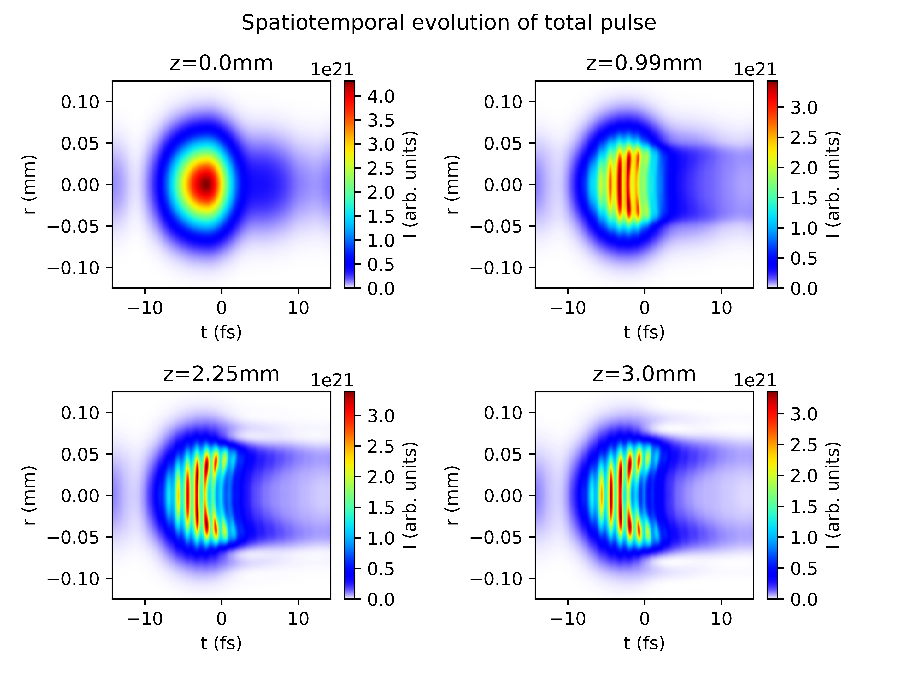
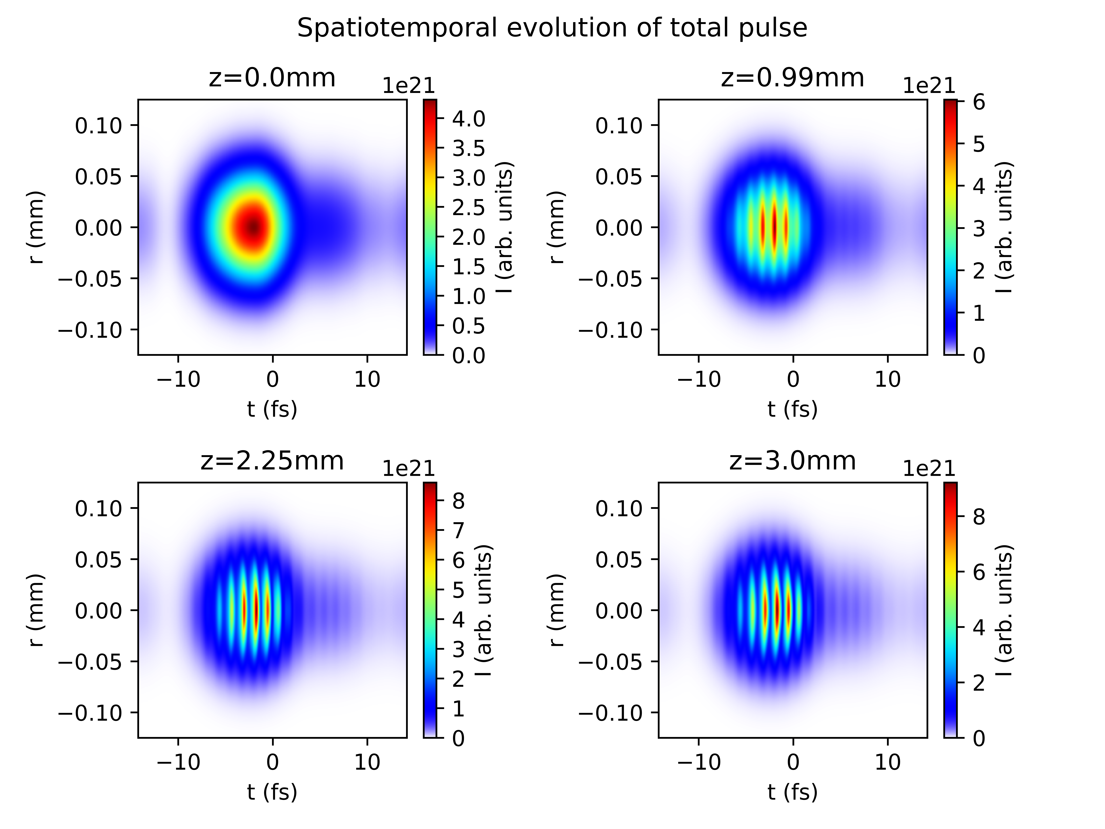
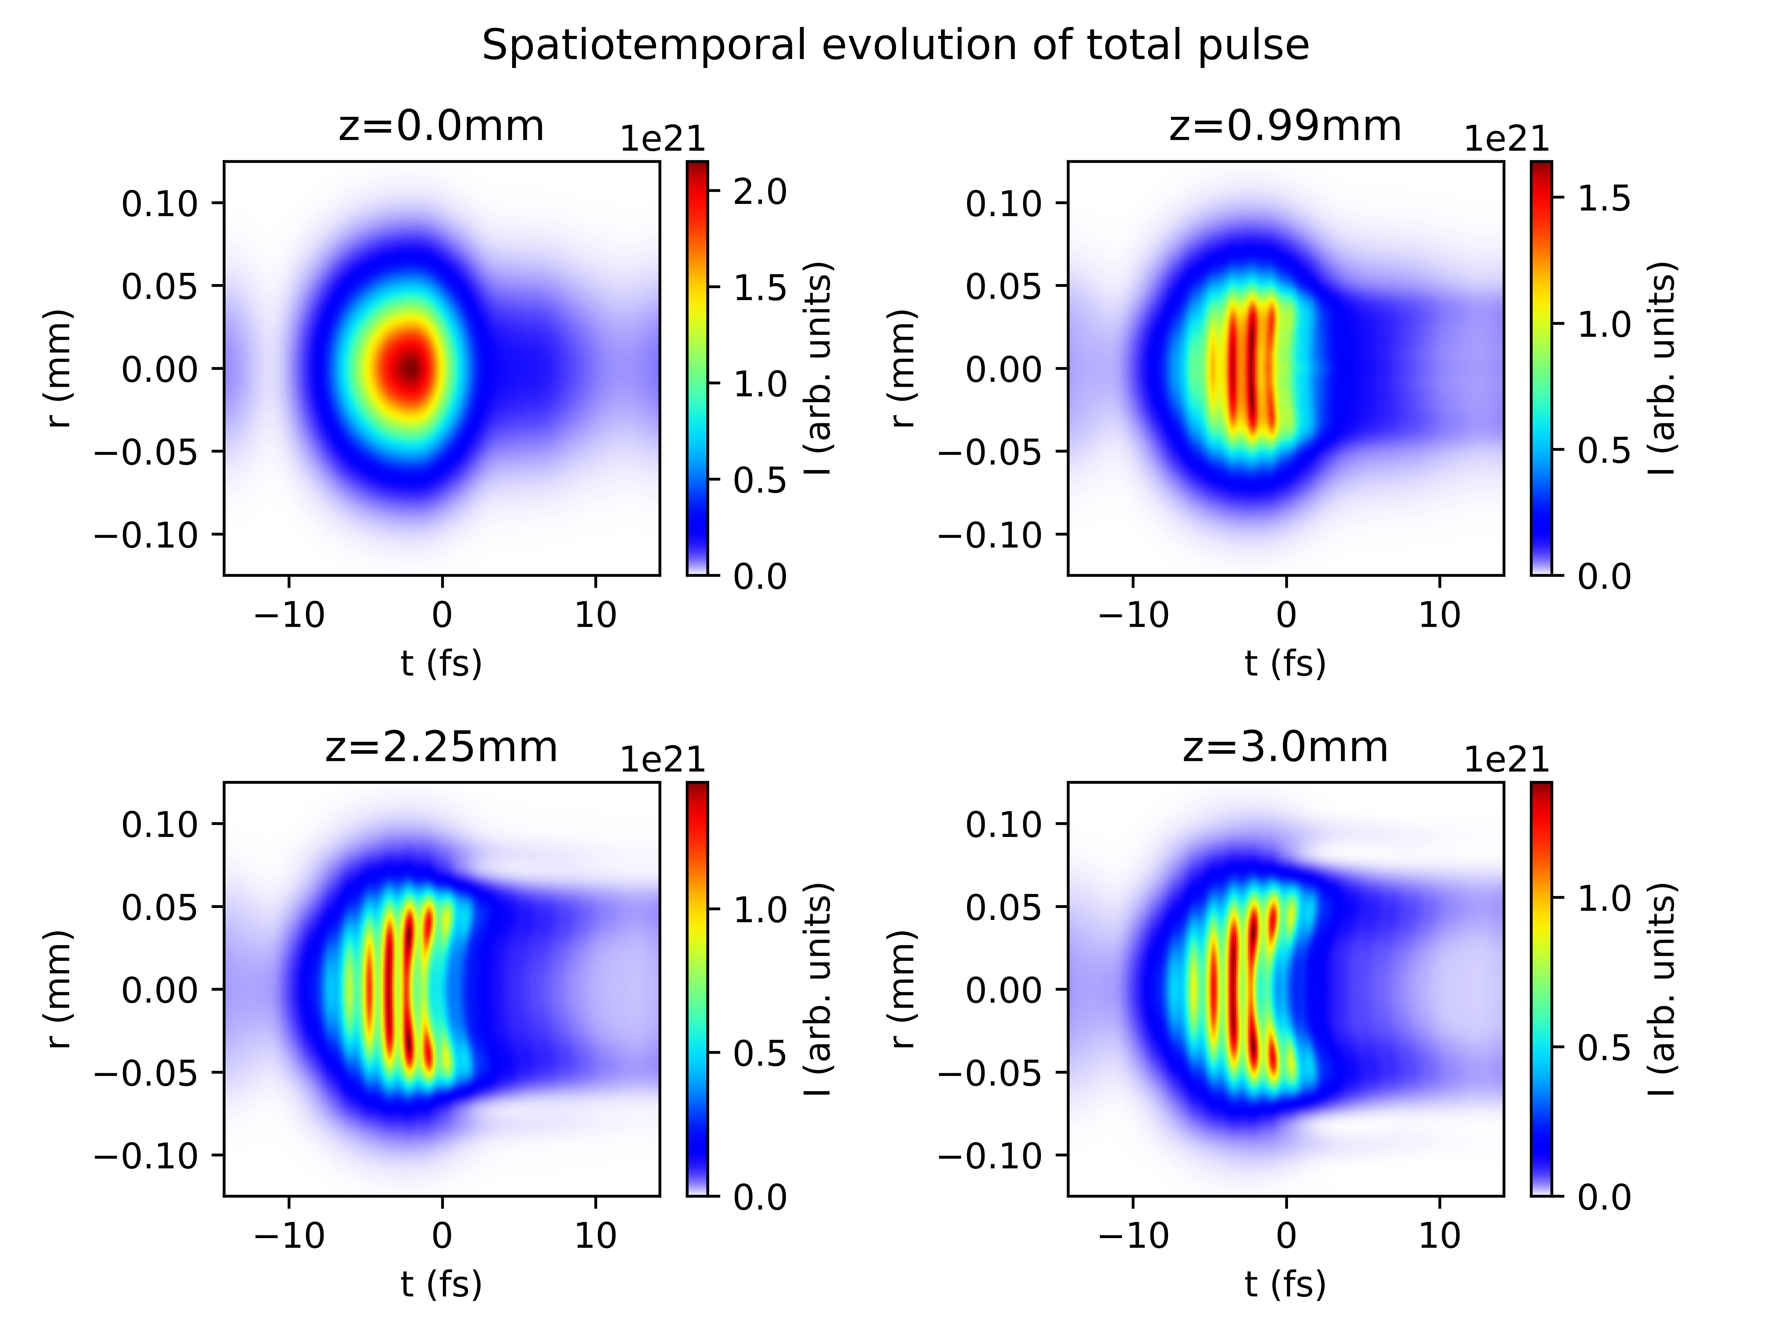
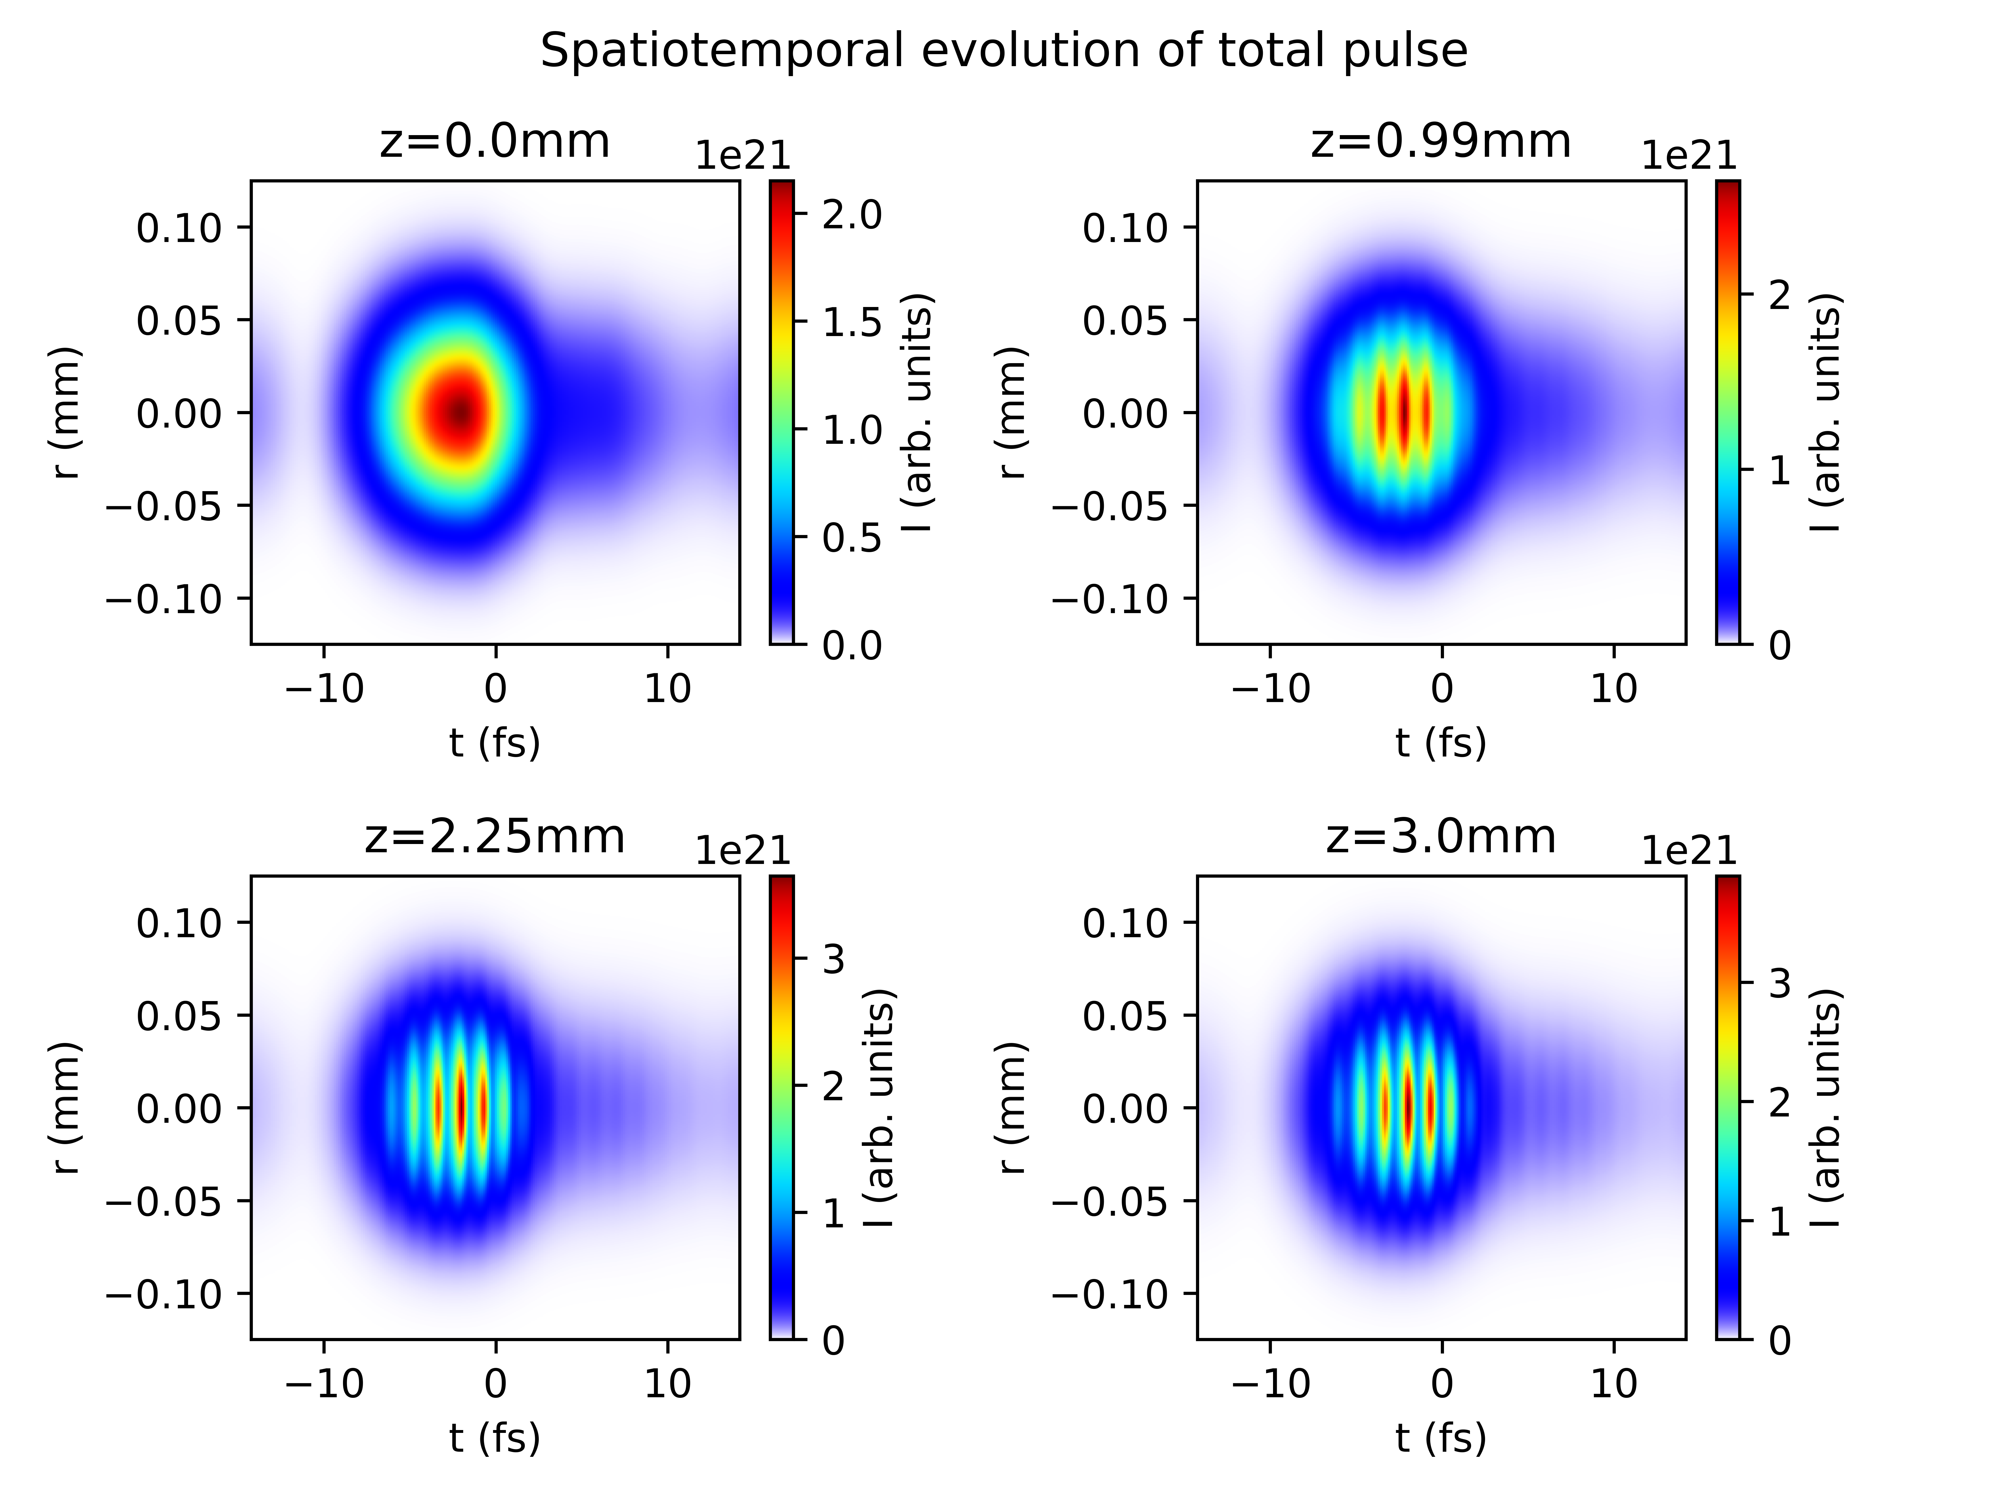
Reproducing plots from Reiter et al. 2010
With ionisation
Without ionisation

Slide 5
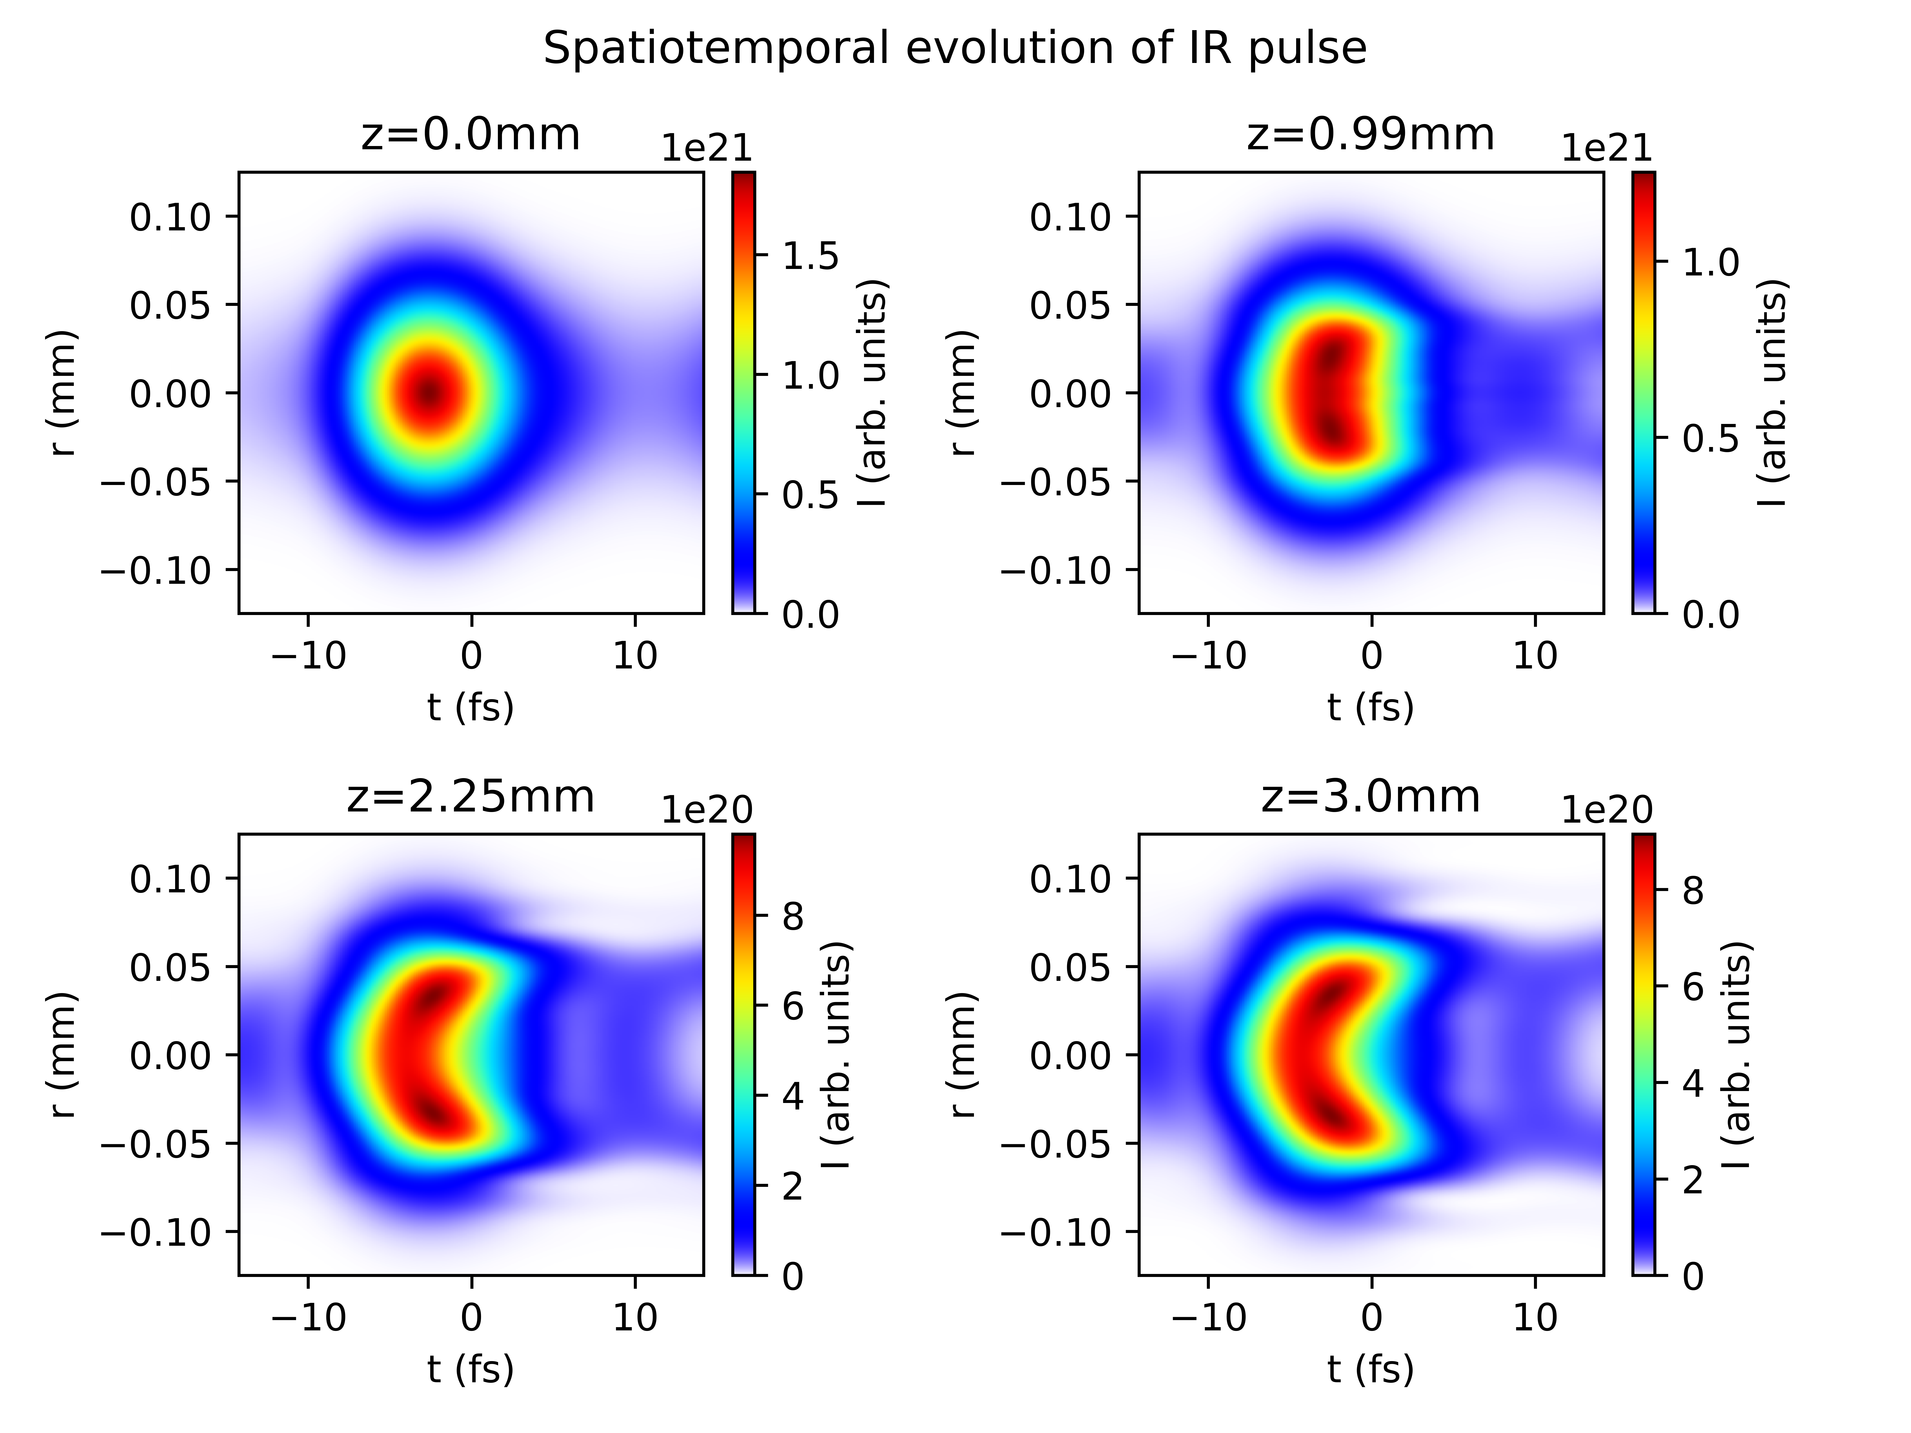
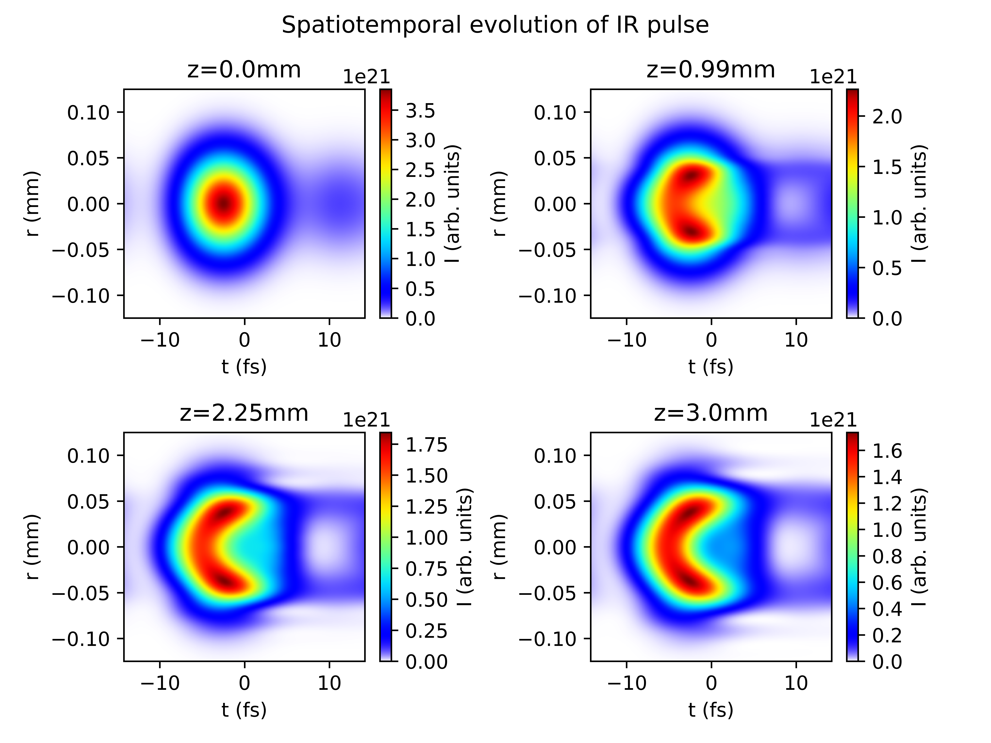
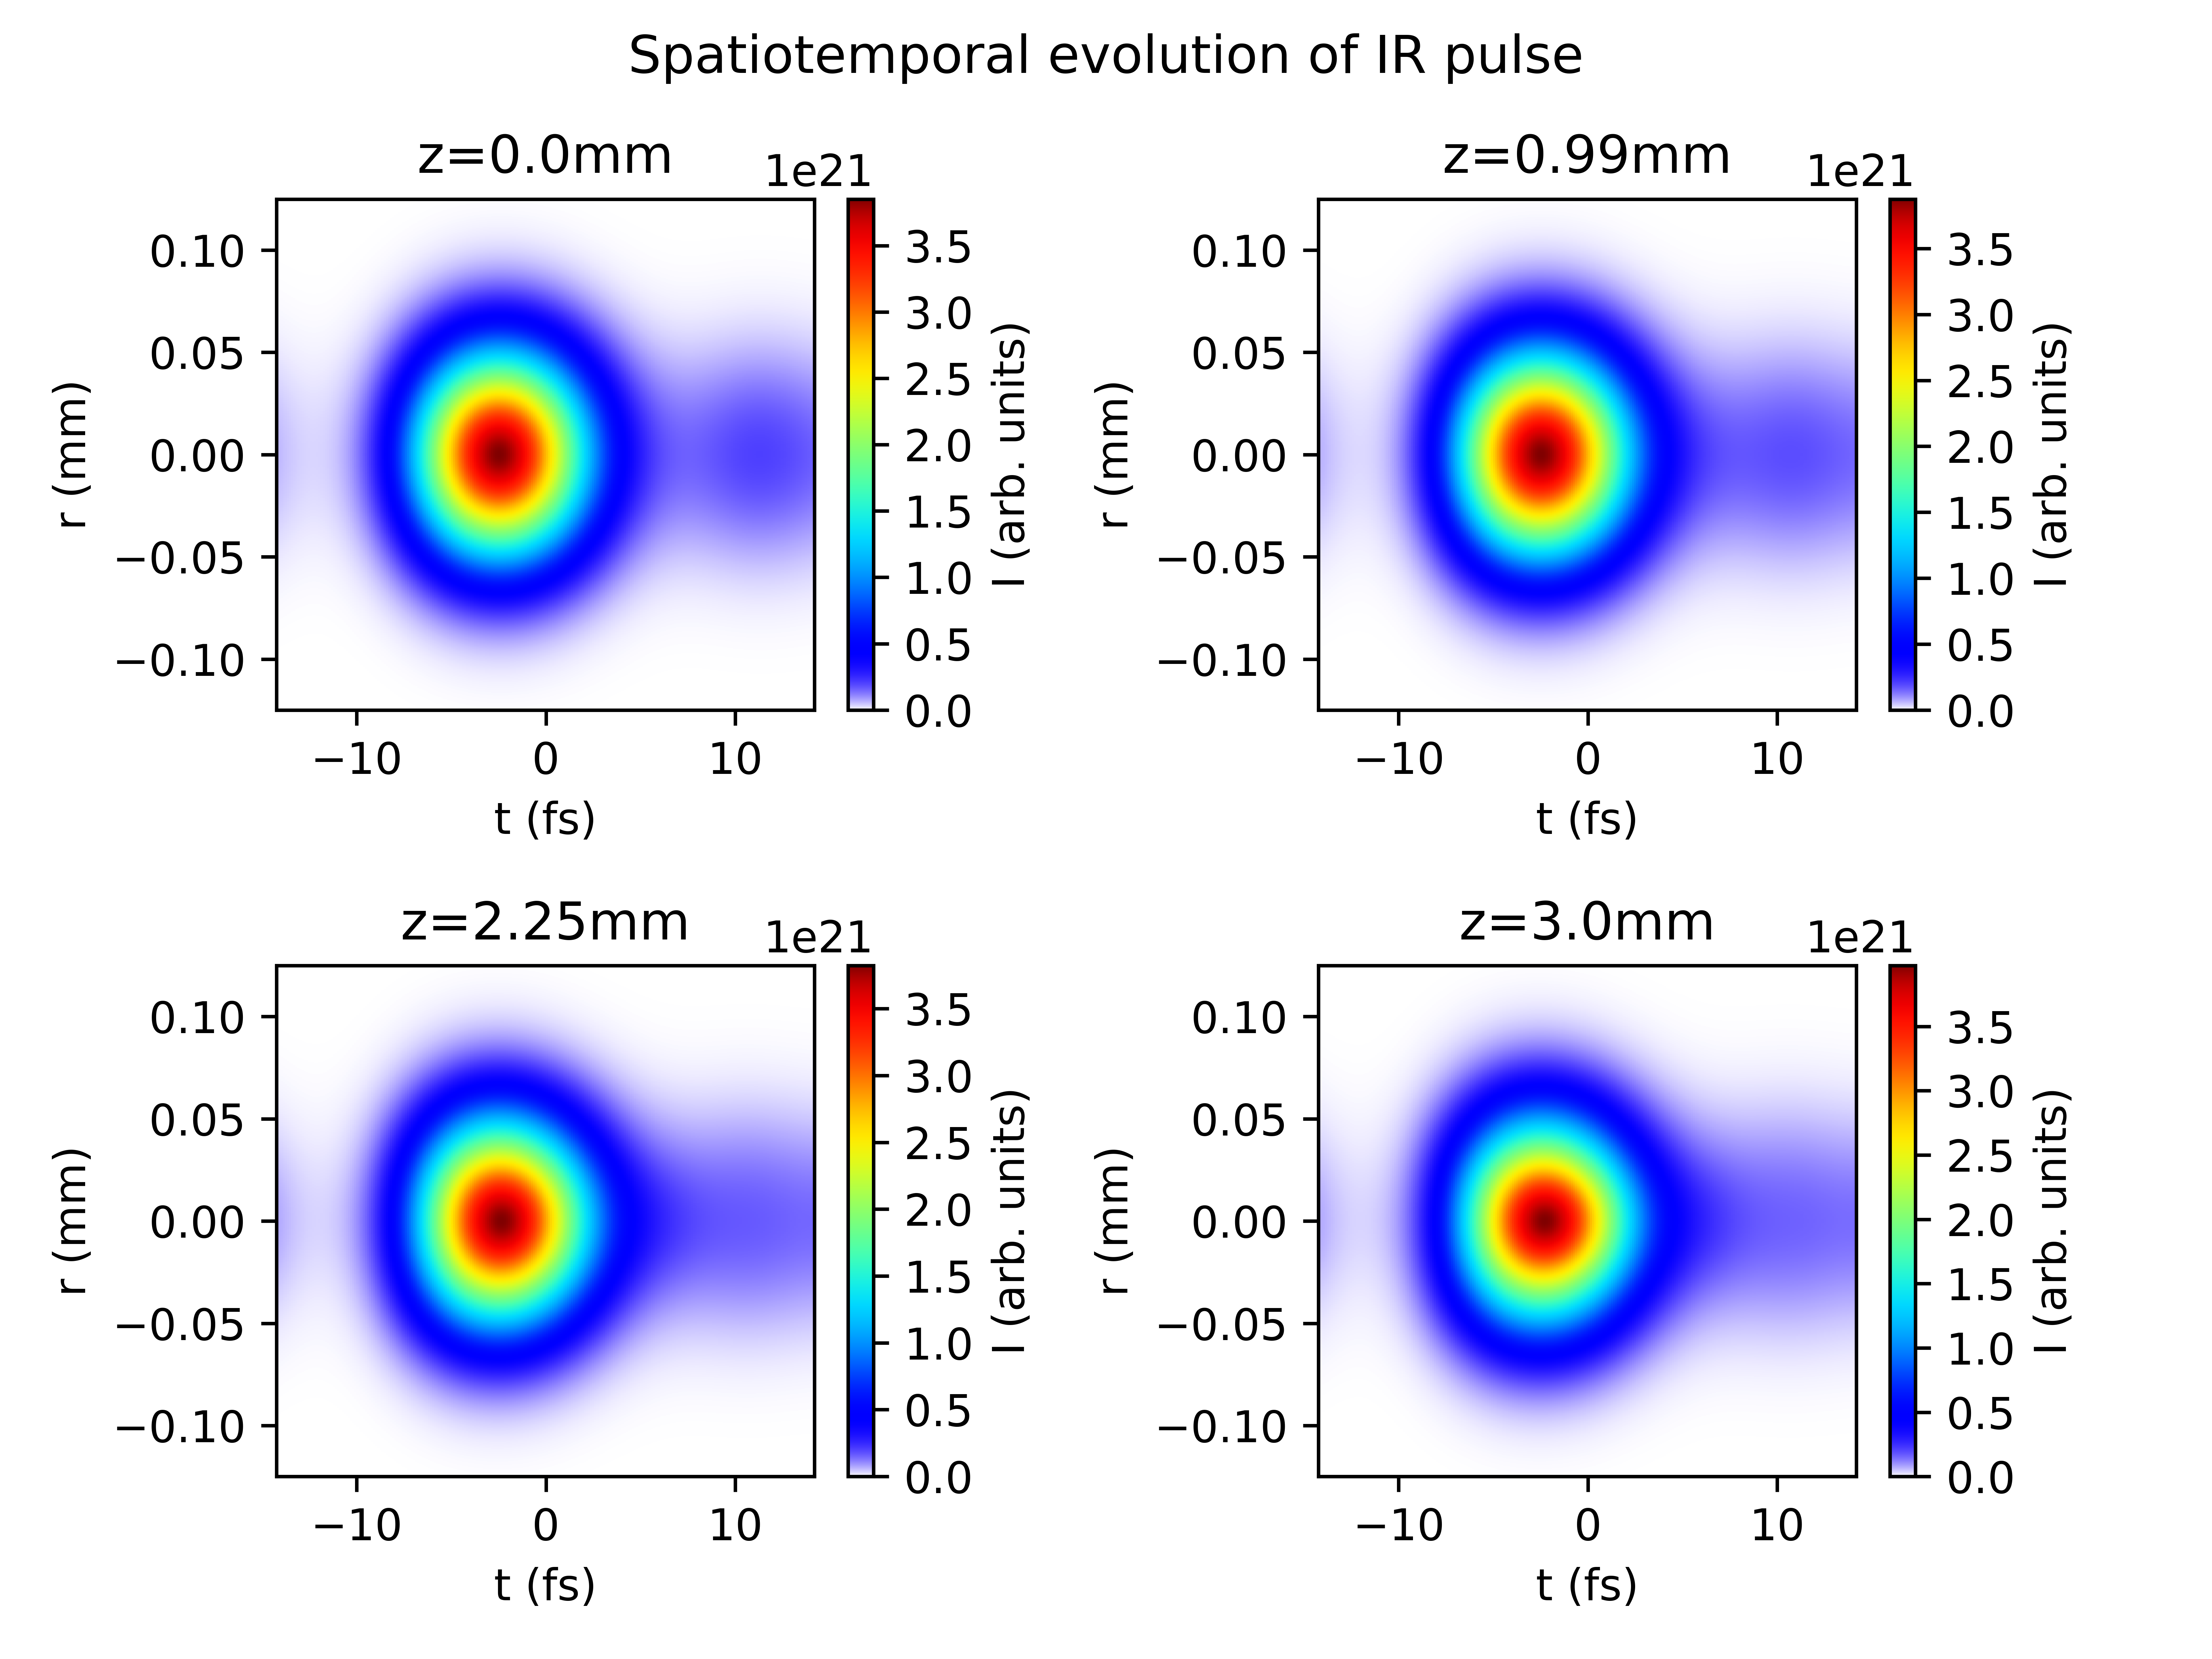
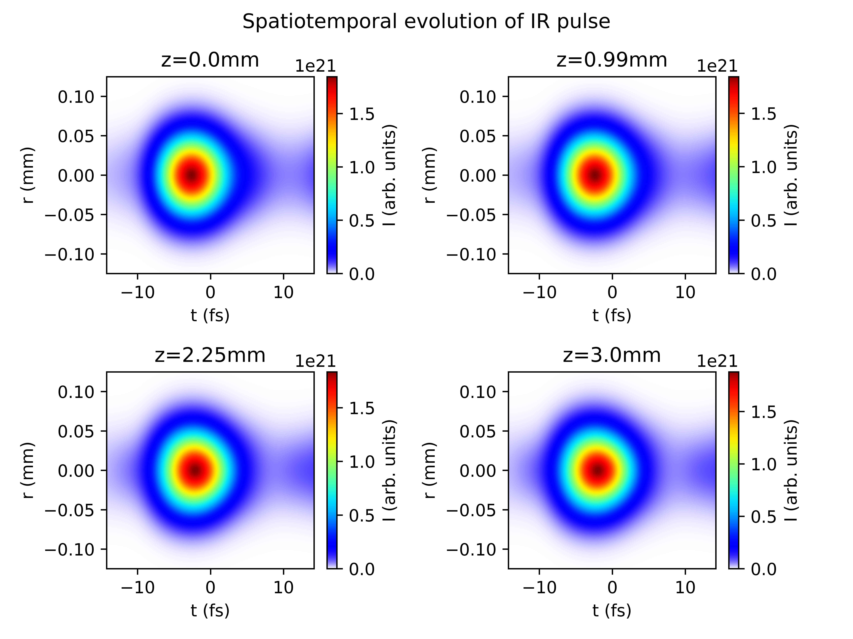
Reproducing plots from Reiter et al. 2010
With ionisation
Without ionisation

Slide 6
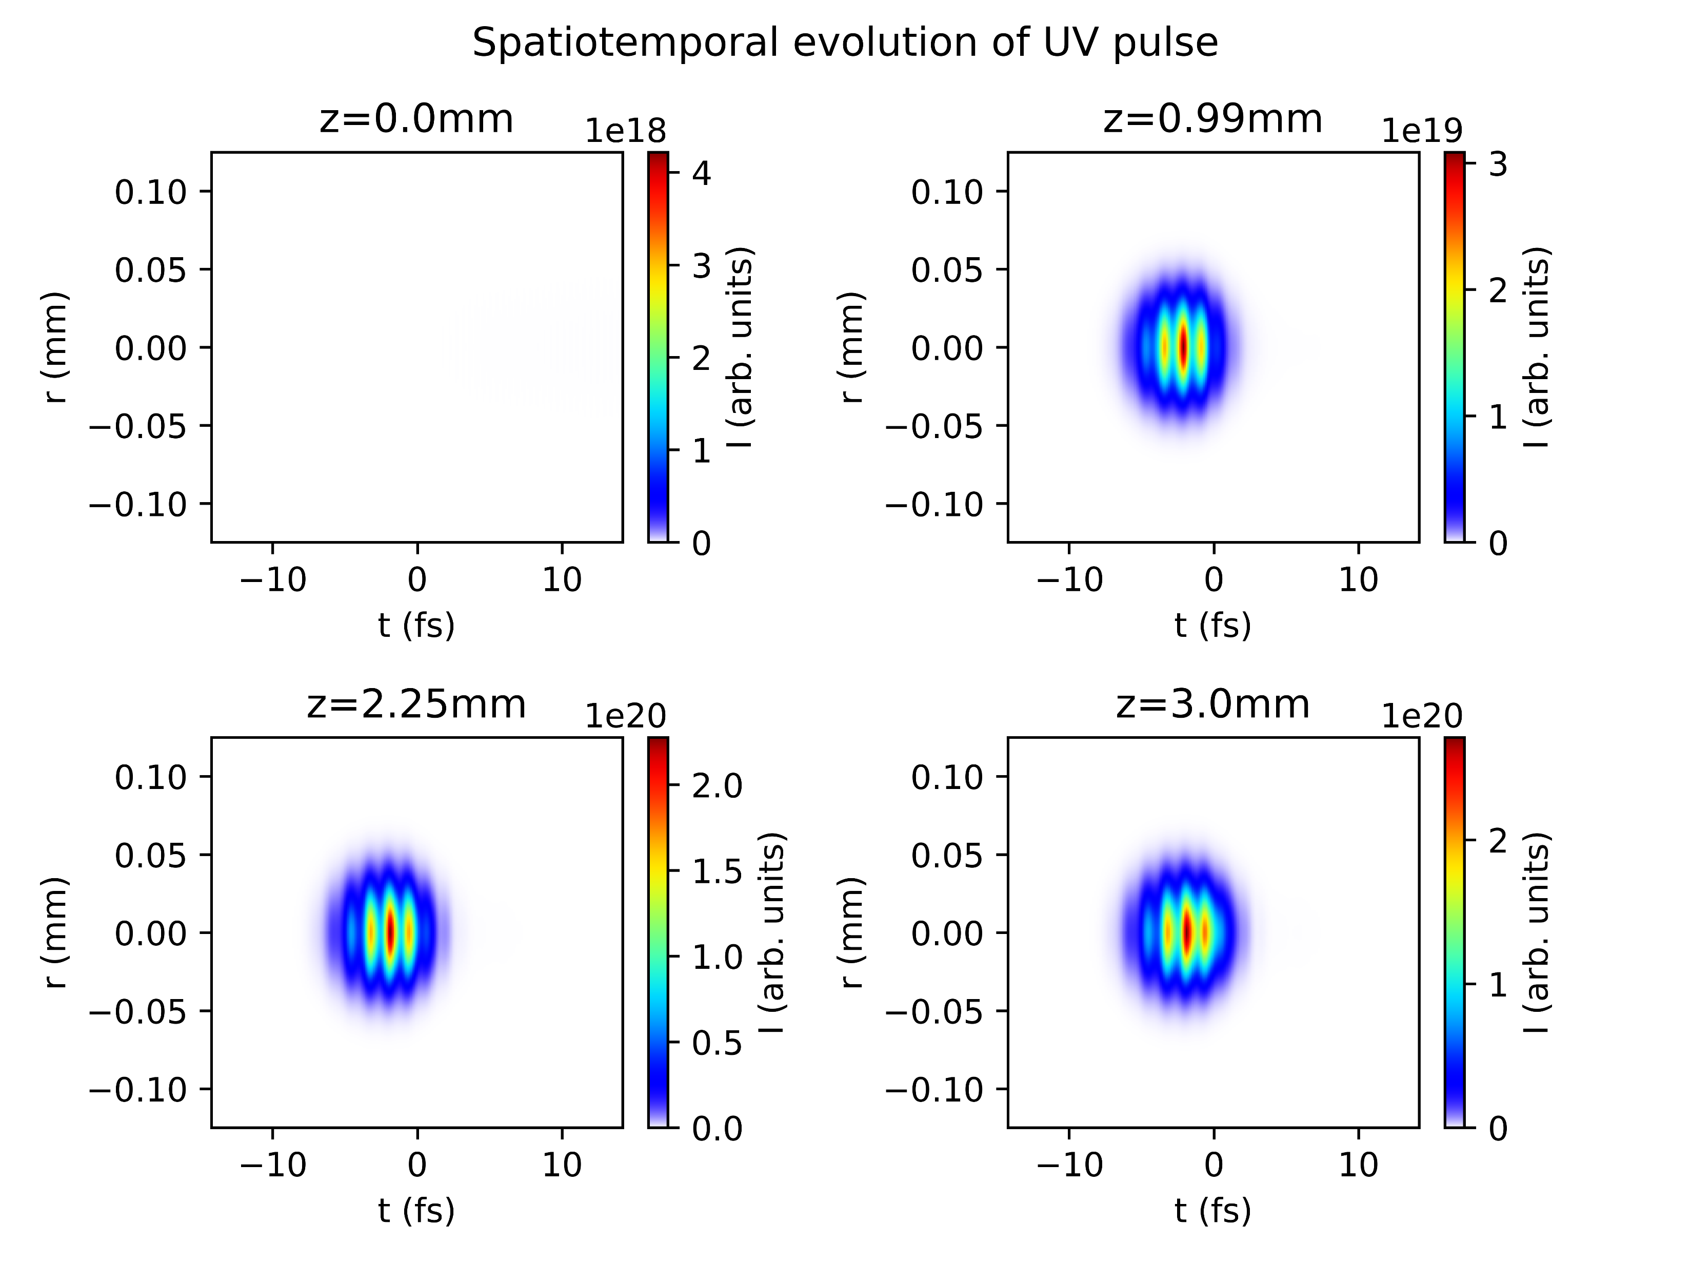
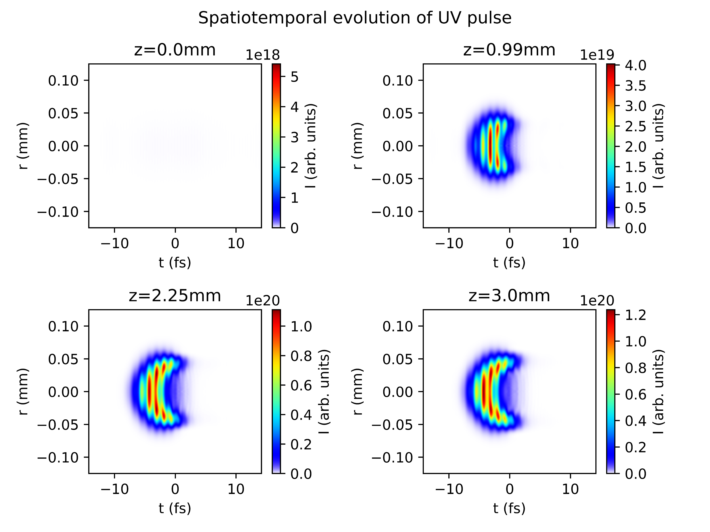
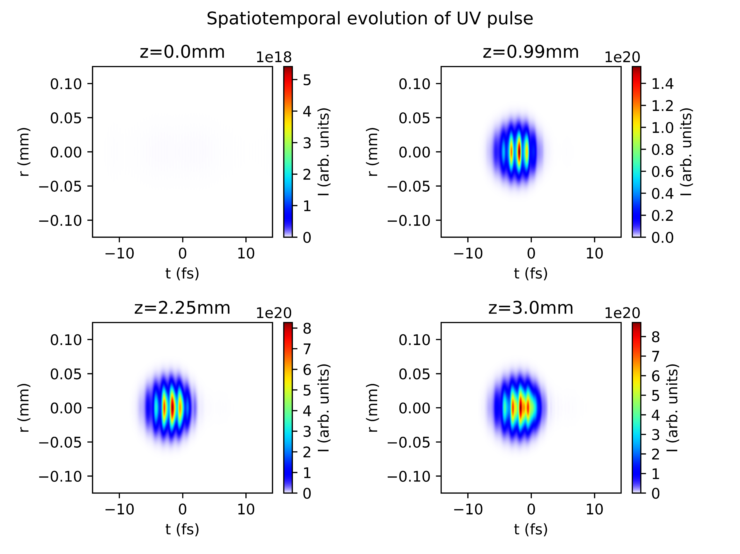

Reproducing plots from Reiter et al. 2010
With ionisation
Without ionisation

Slide 7
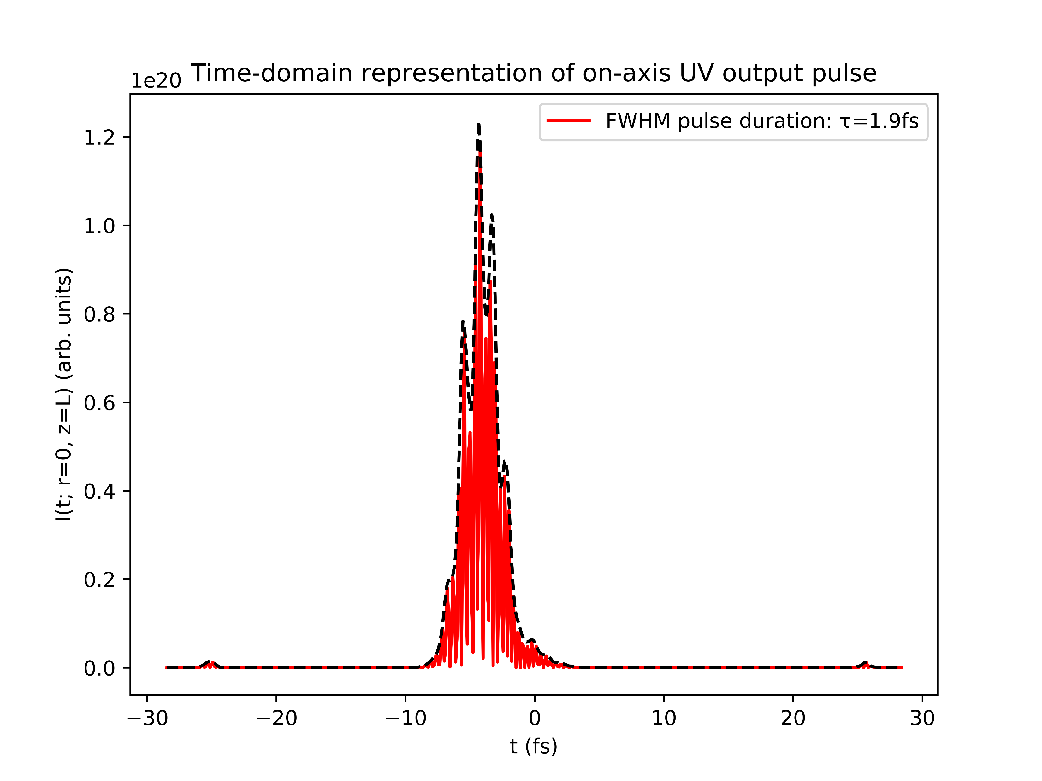
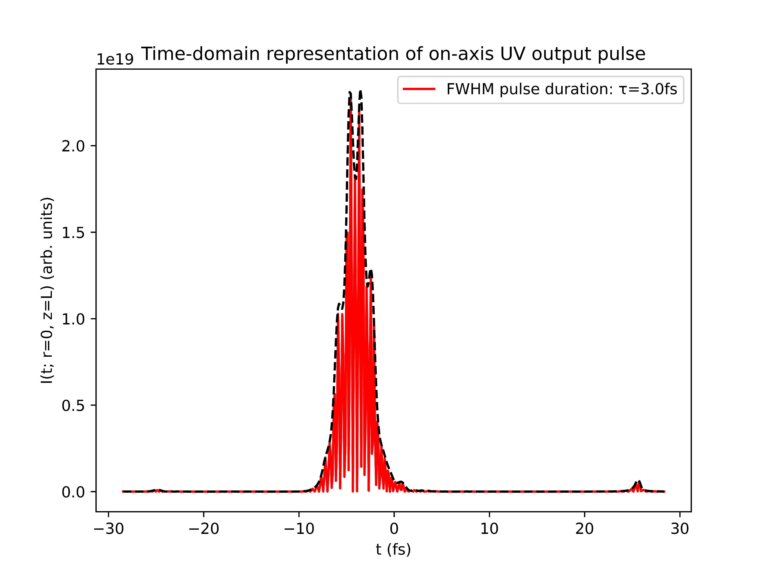
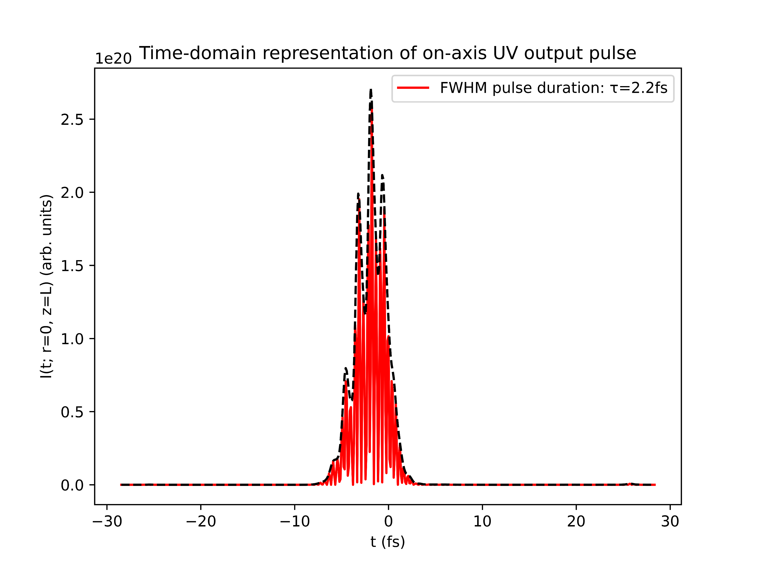
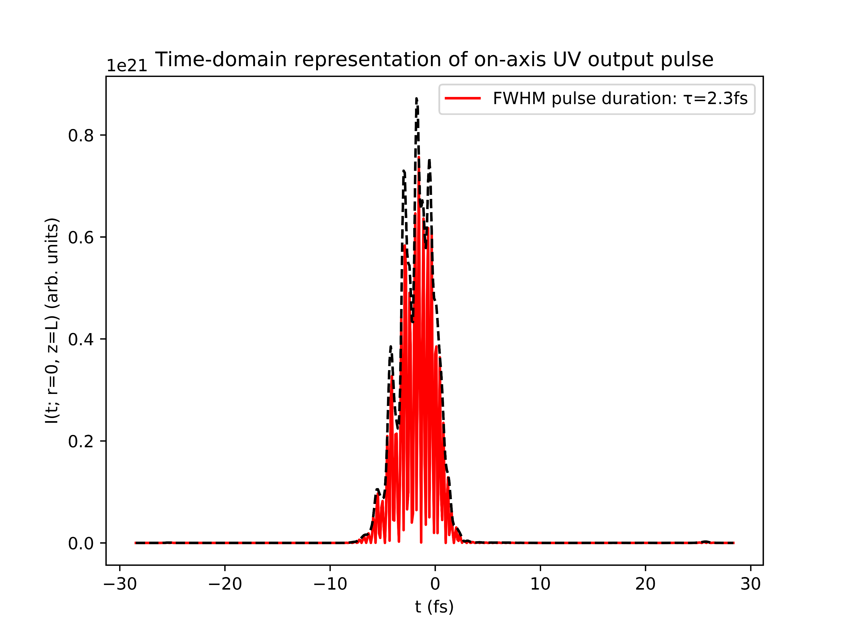
Reproducing plots from Reiter et al. 2010
With ionisation
Without ionisation

Slide 8
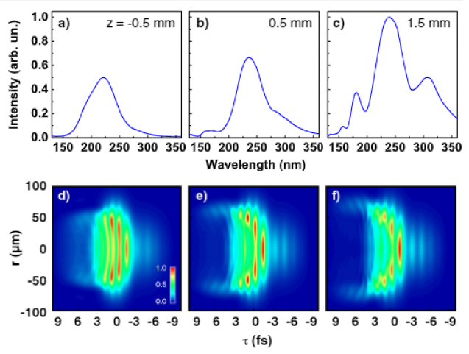
Reproducing plots from Reiter et al. 2010
Simulations show very clear trailing-edge self-steepening in the IR pulse and the UV pulse
Turning off ionisation mostly suppresses this effect and increases the pulse duration
The simulations could not reproduce the core features of Reiter
Is there something fundamentally wrong with the model?
Reiter 2010 (UV; with ionisation)

Slide 9
List items for discussion with Chris (Luna)
Lacking documentation for Nonlinear.jl response functions
in particular: how do KerrField, PlasmaCumtrapz, etc. relate to specific terms in the UPPE?
Extracting temporal/spectral phase information
Breakdown in PlasmaScalar! Ionisation function
Note: potential fix using ADK ionisation instead of PPT
Spatial grids with centring on zero?
Current problem with COMSOL implementation

Slide 10
Position of beam focus
Changing the beam focus position seems to affect a wide variety of pulse parameters:
output pulse duration
spatiotemporal pulse profile
total pulse energy
…
So far, only cursory exploration (see next slides)
Worthwhile to investigate further?

Slide 11
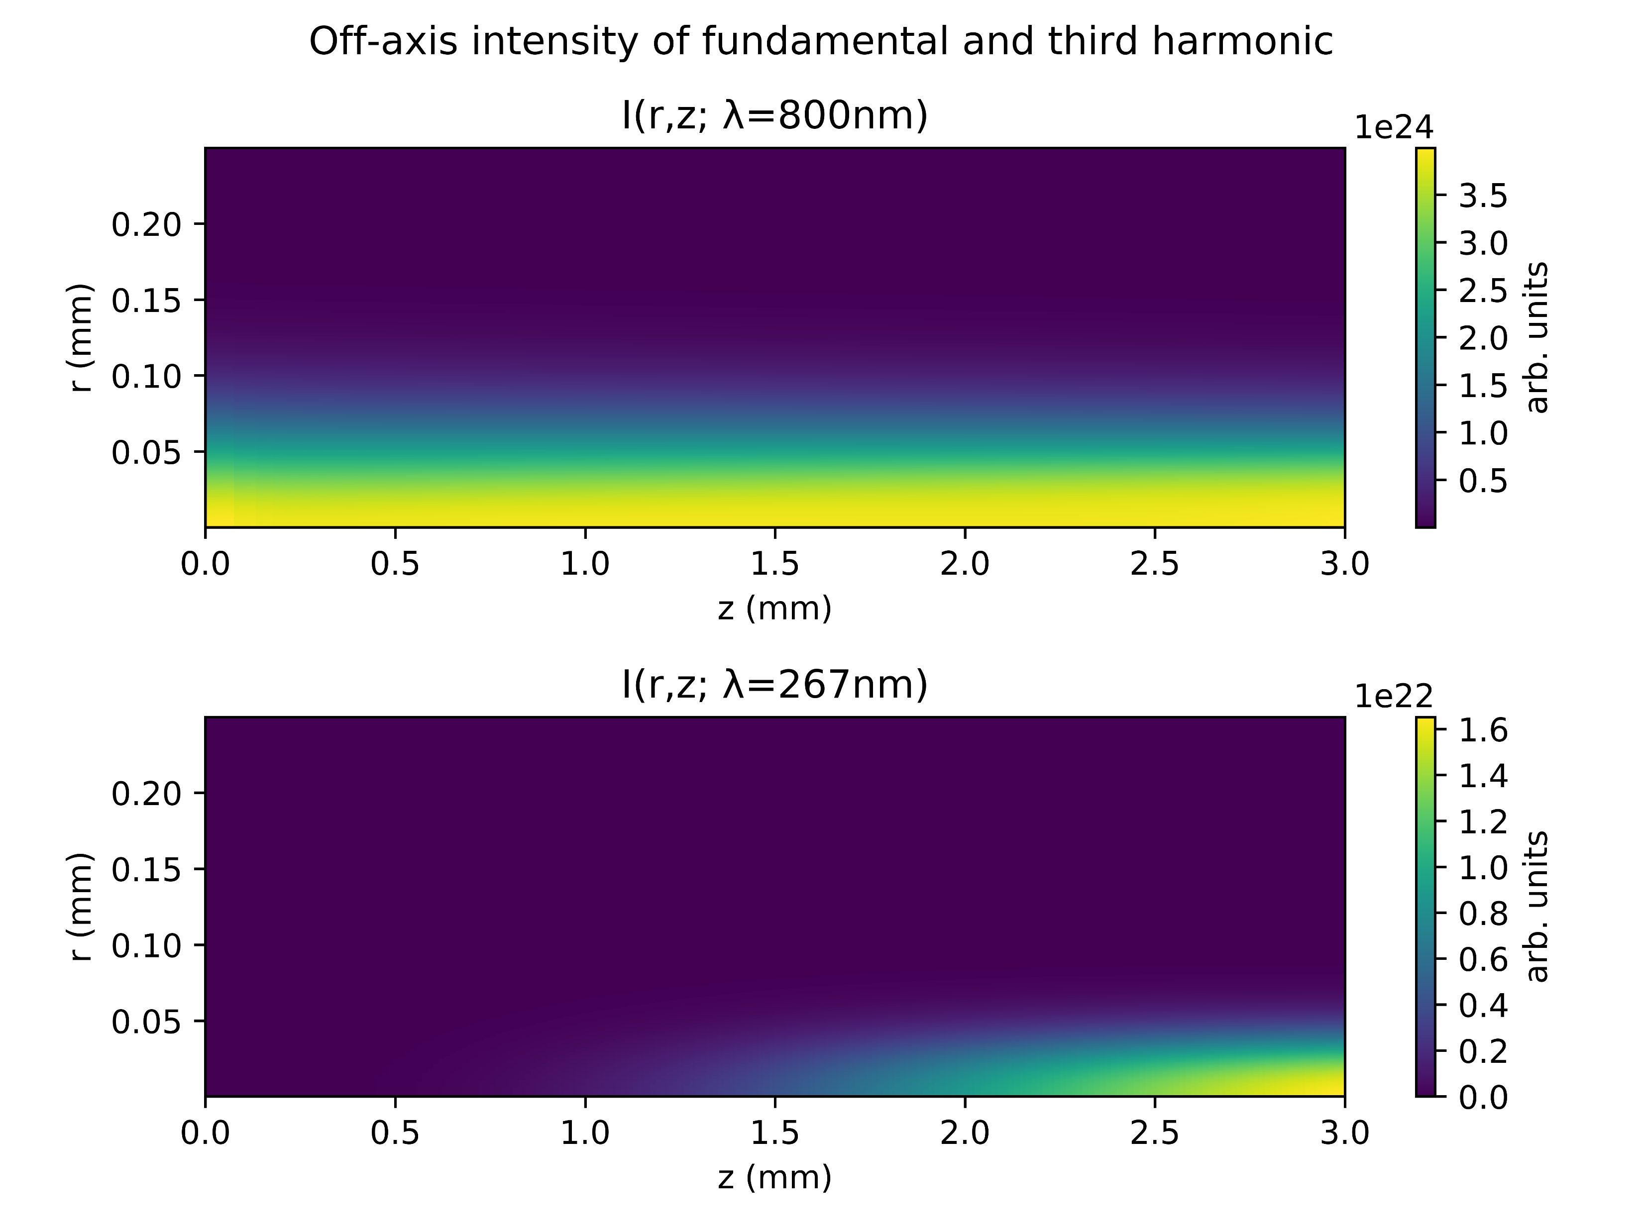
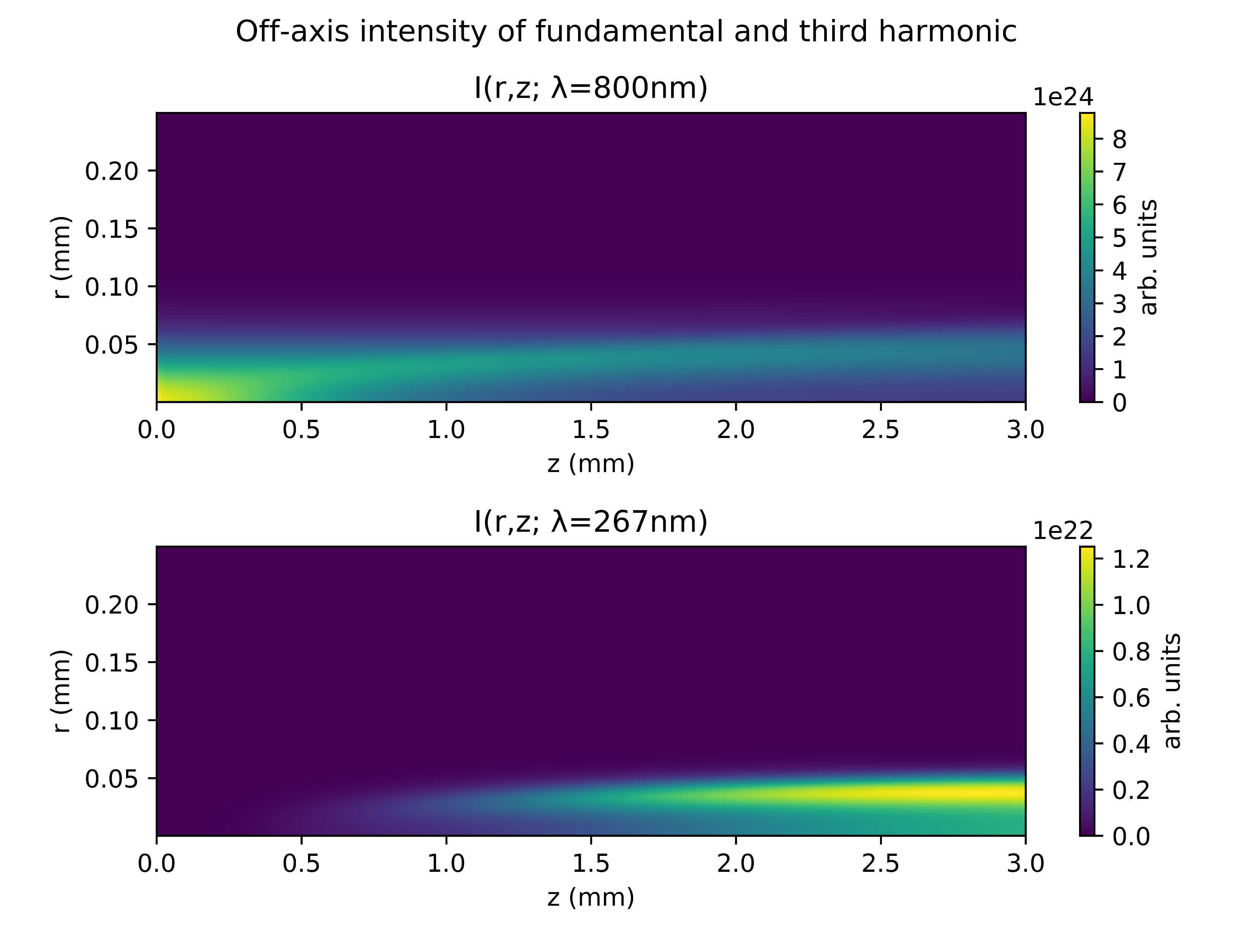
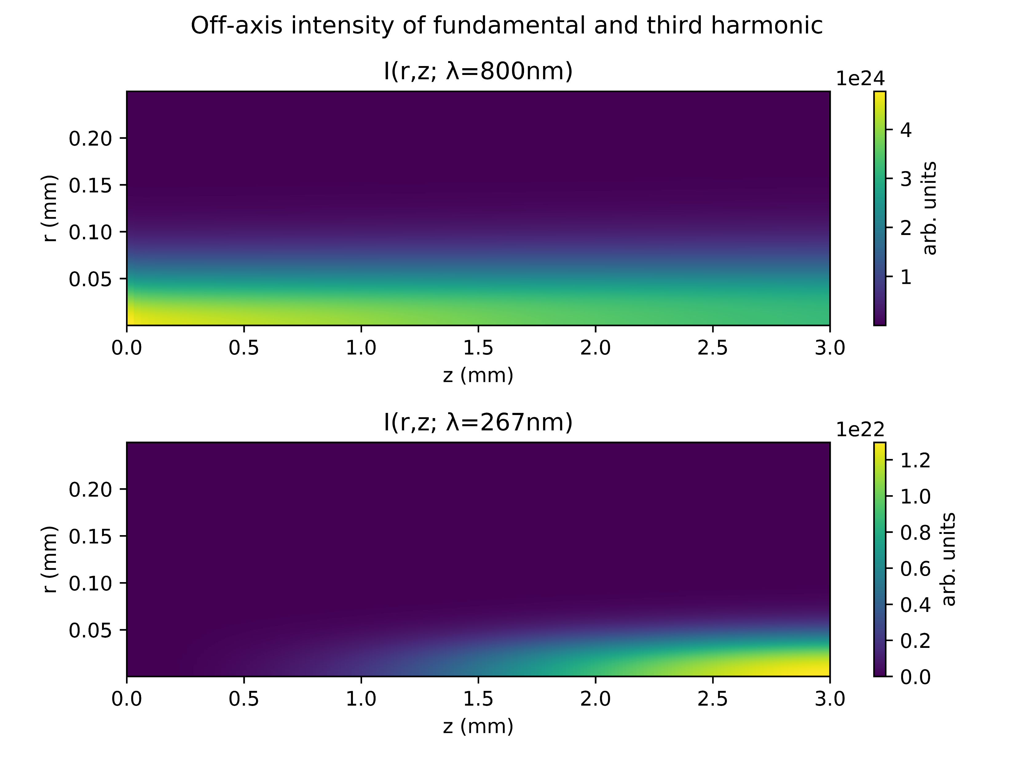
Position of beam focus
Shift by zr to the left
Centred focus
Shift by zr to the right

Slide 12

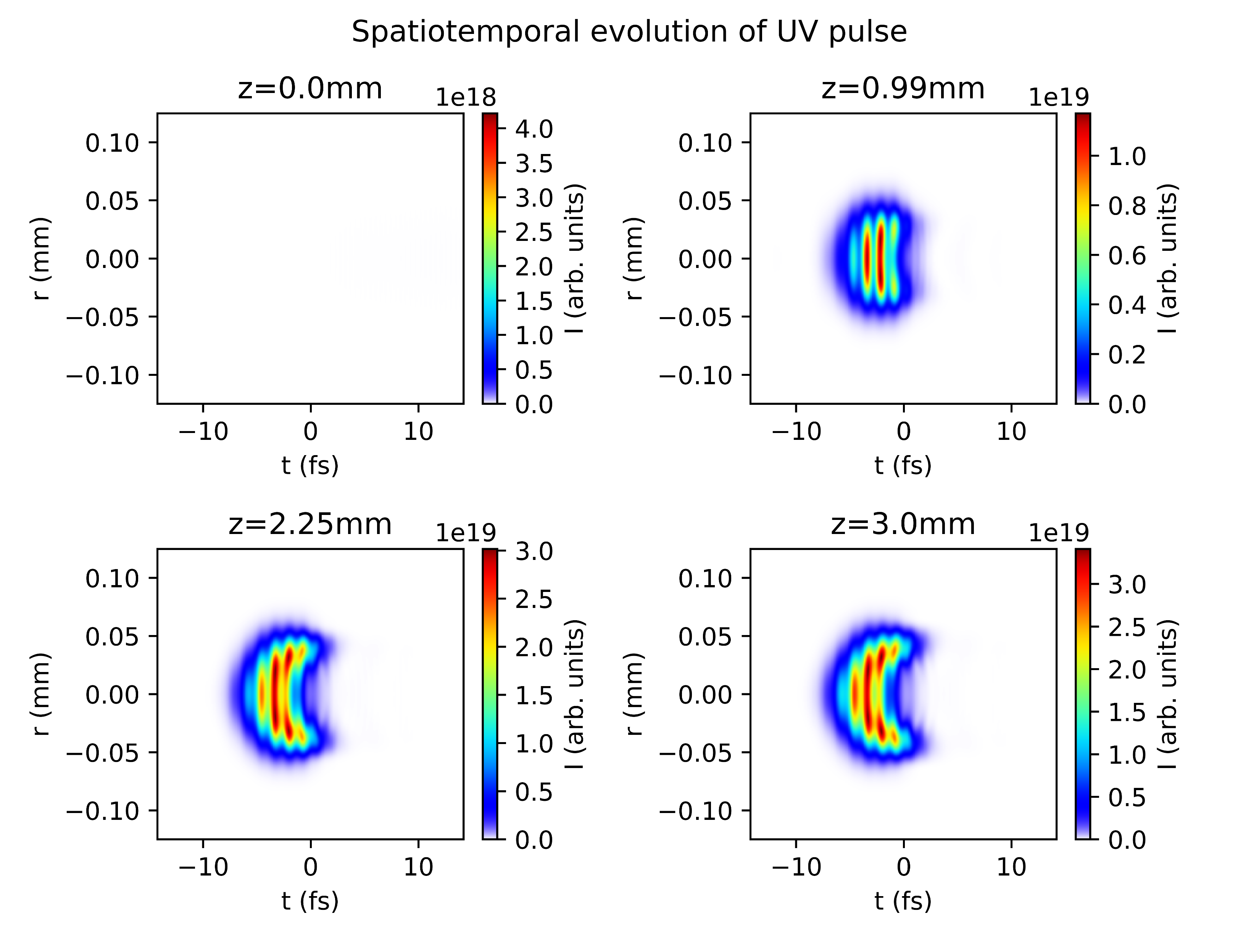
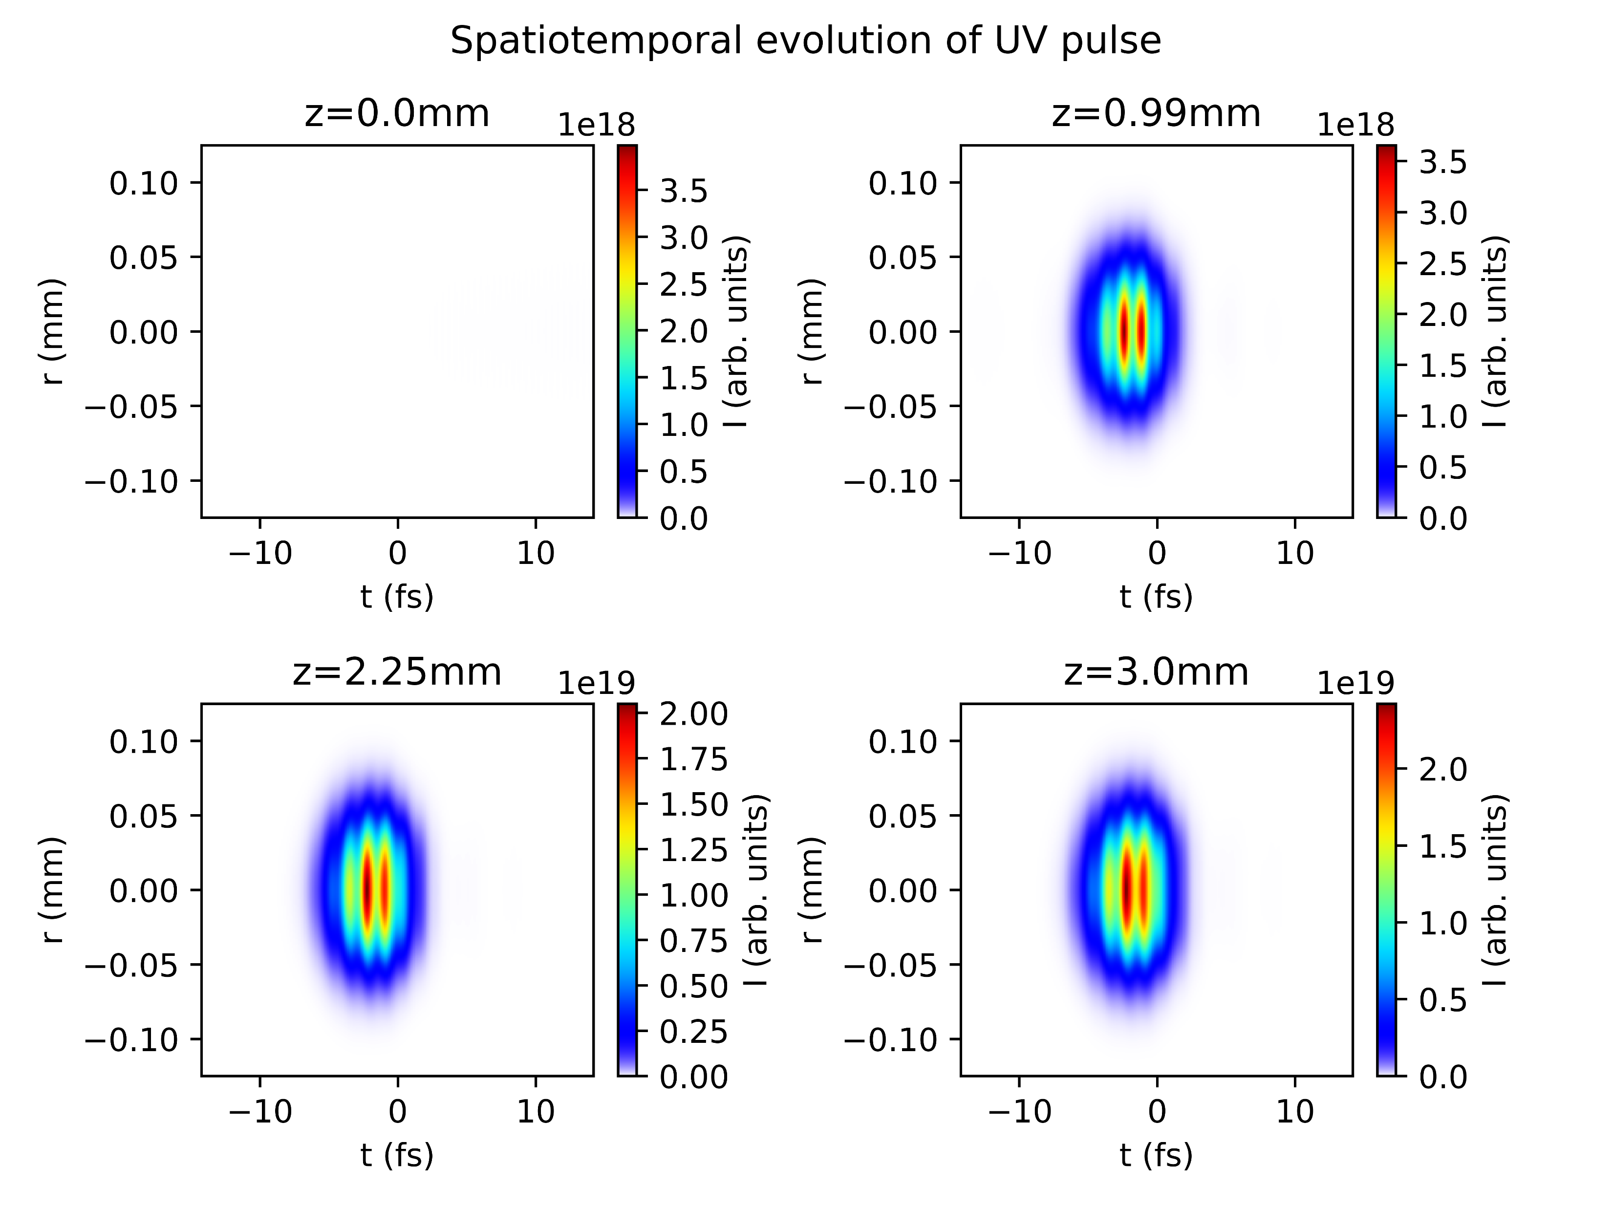
Position of beam focus
Shift by zr to the left
Centred focus
Shift by zr to the right

Slide 13
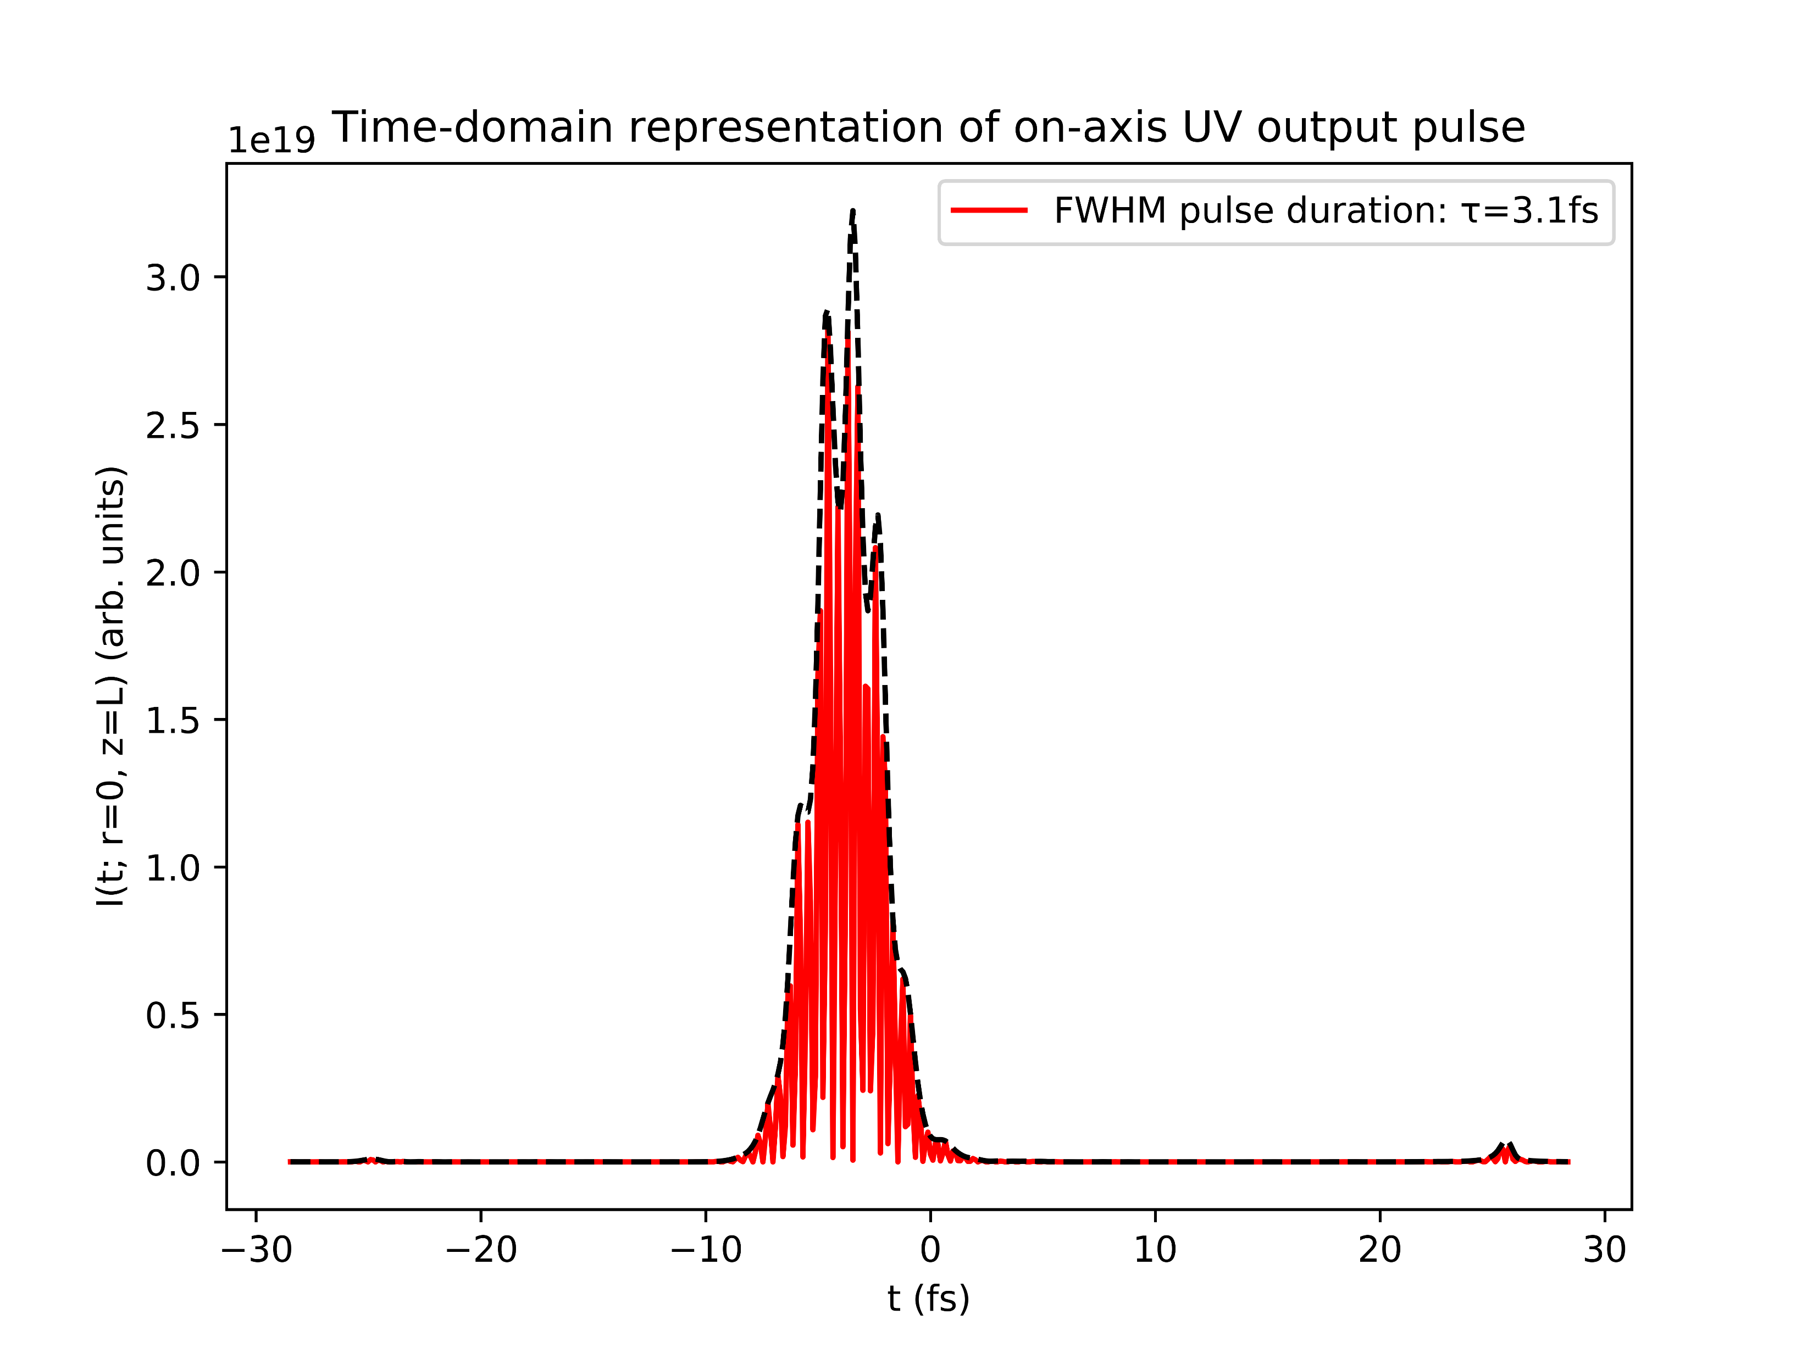
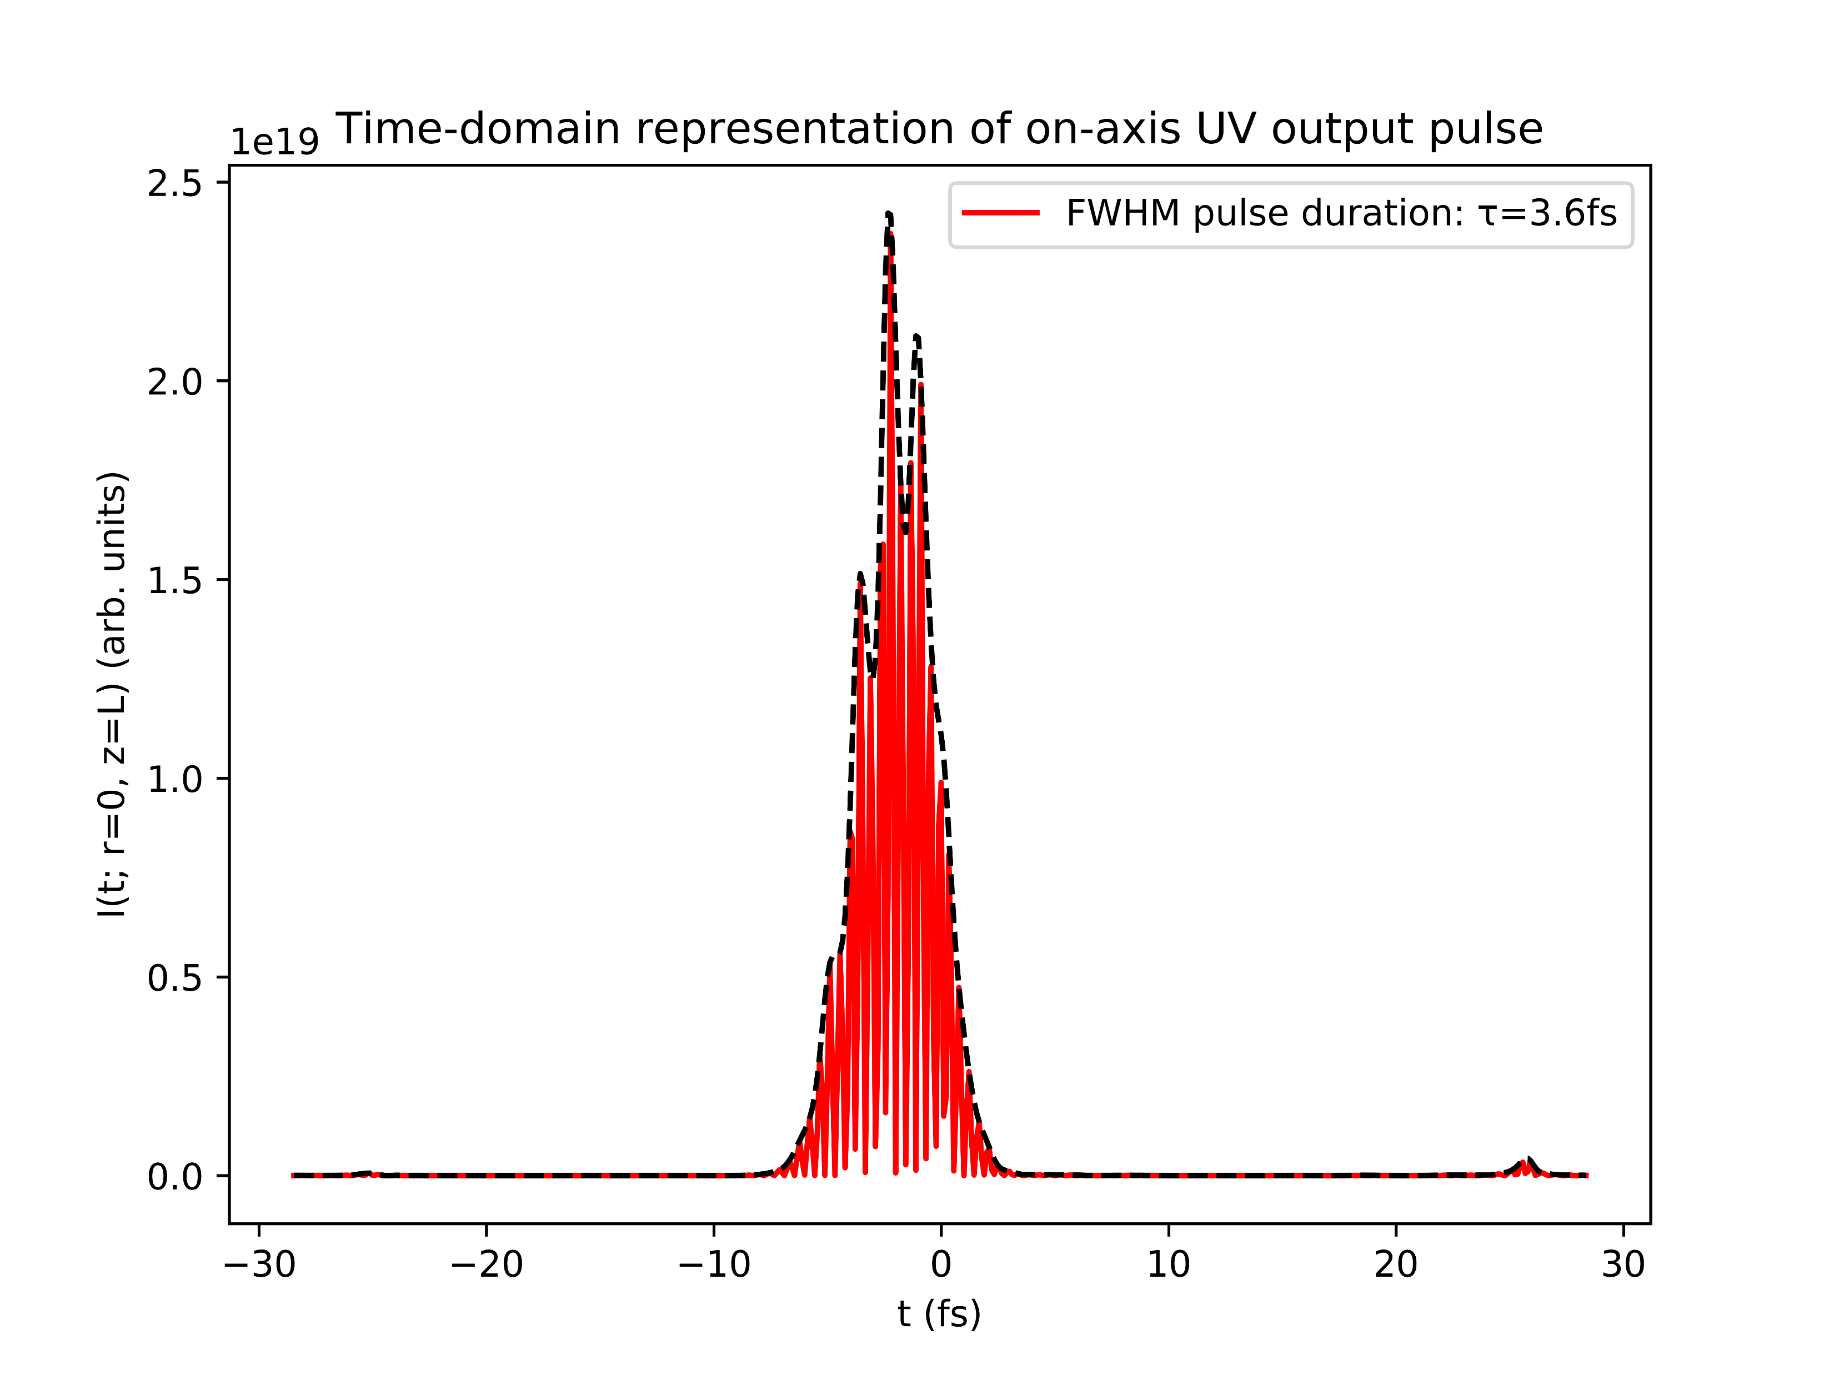
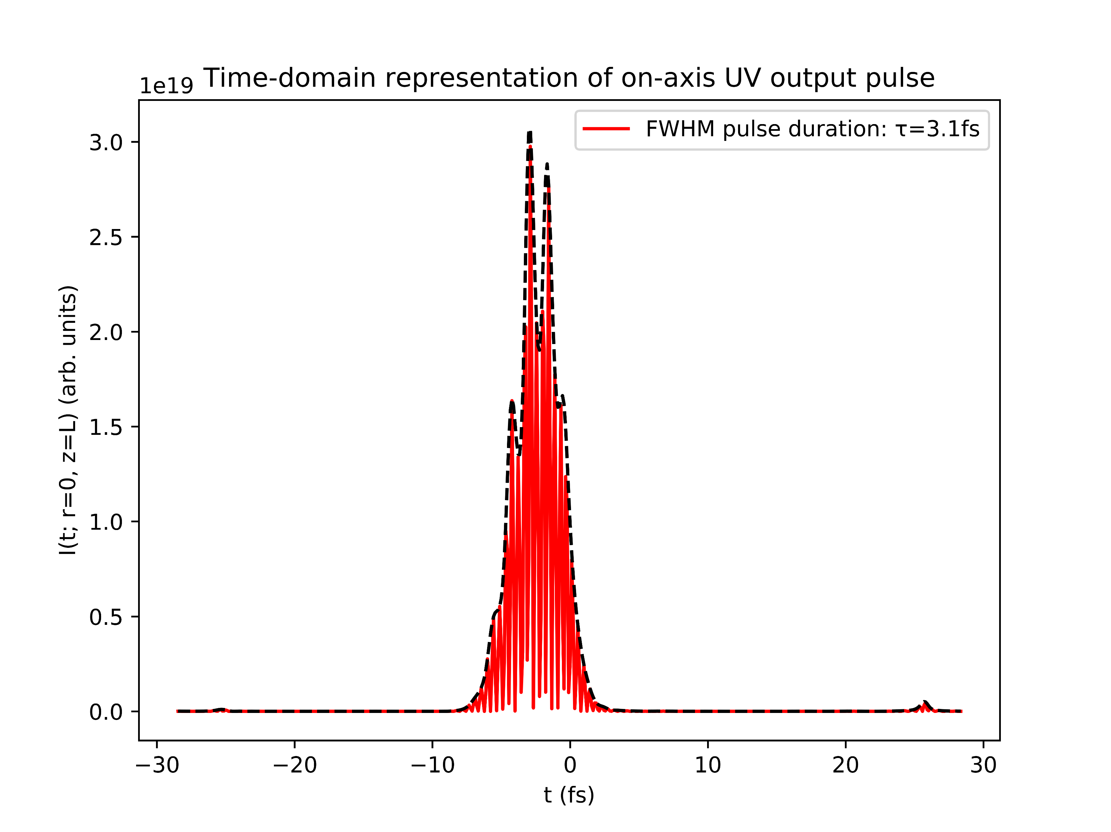
Position of beam focus
Shift by zr to the left
Centred focus
Shift by zr to the right

Slide 14
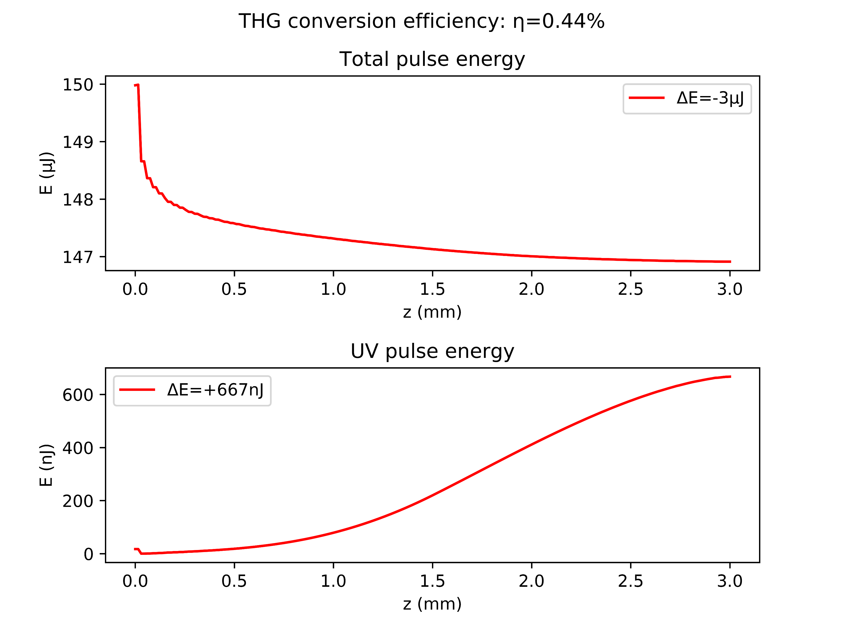
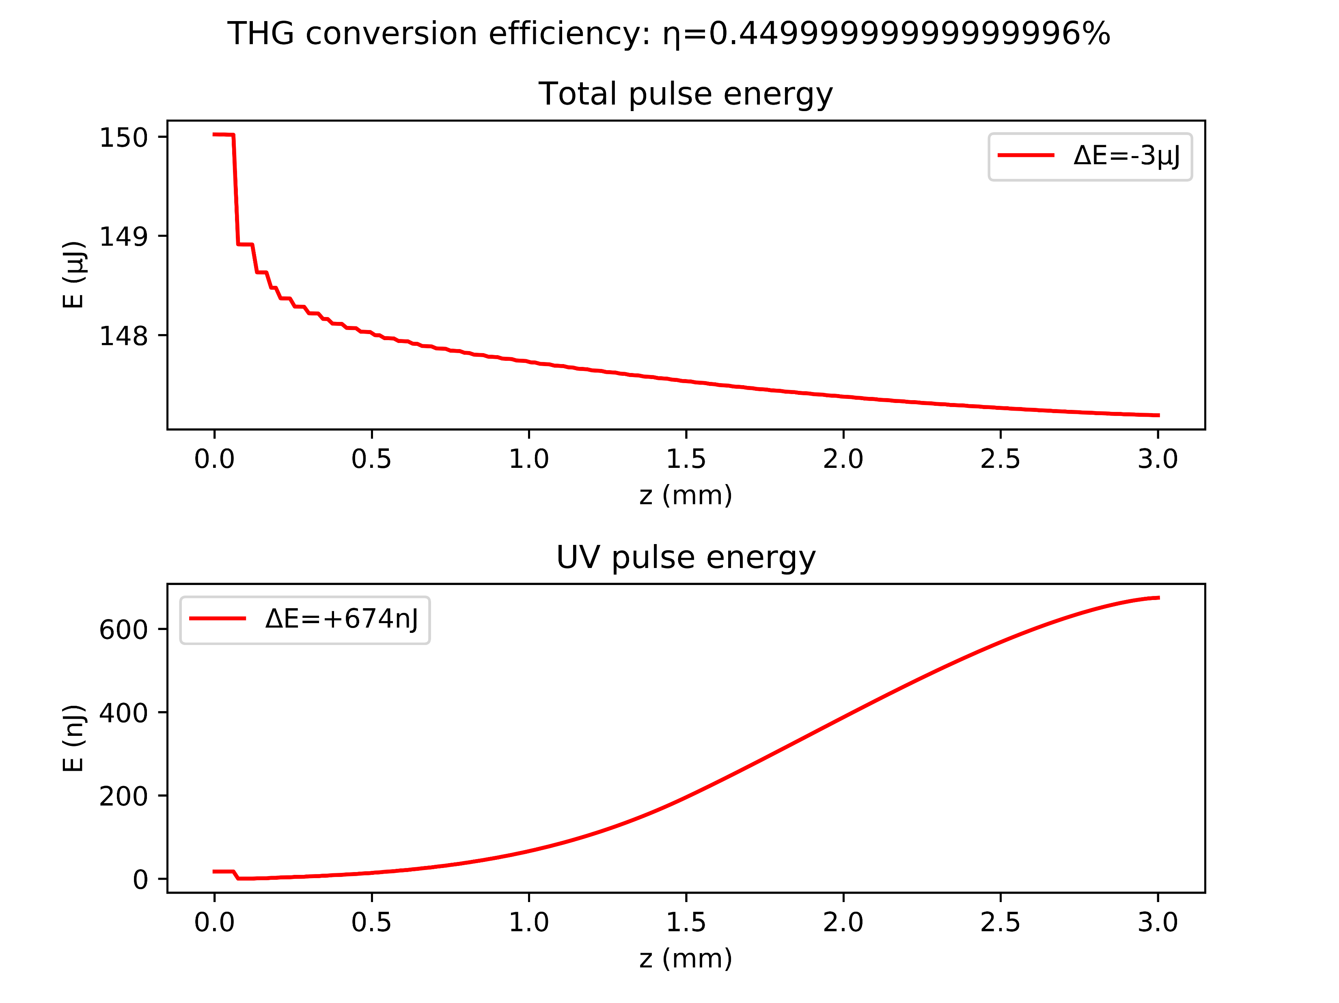
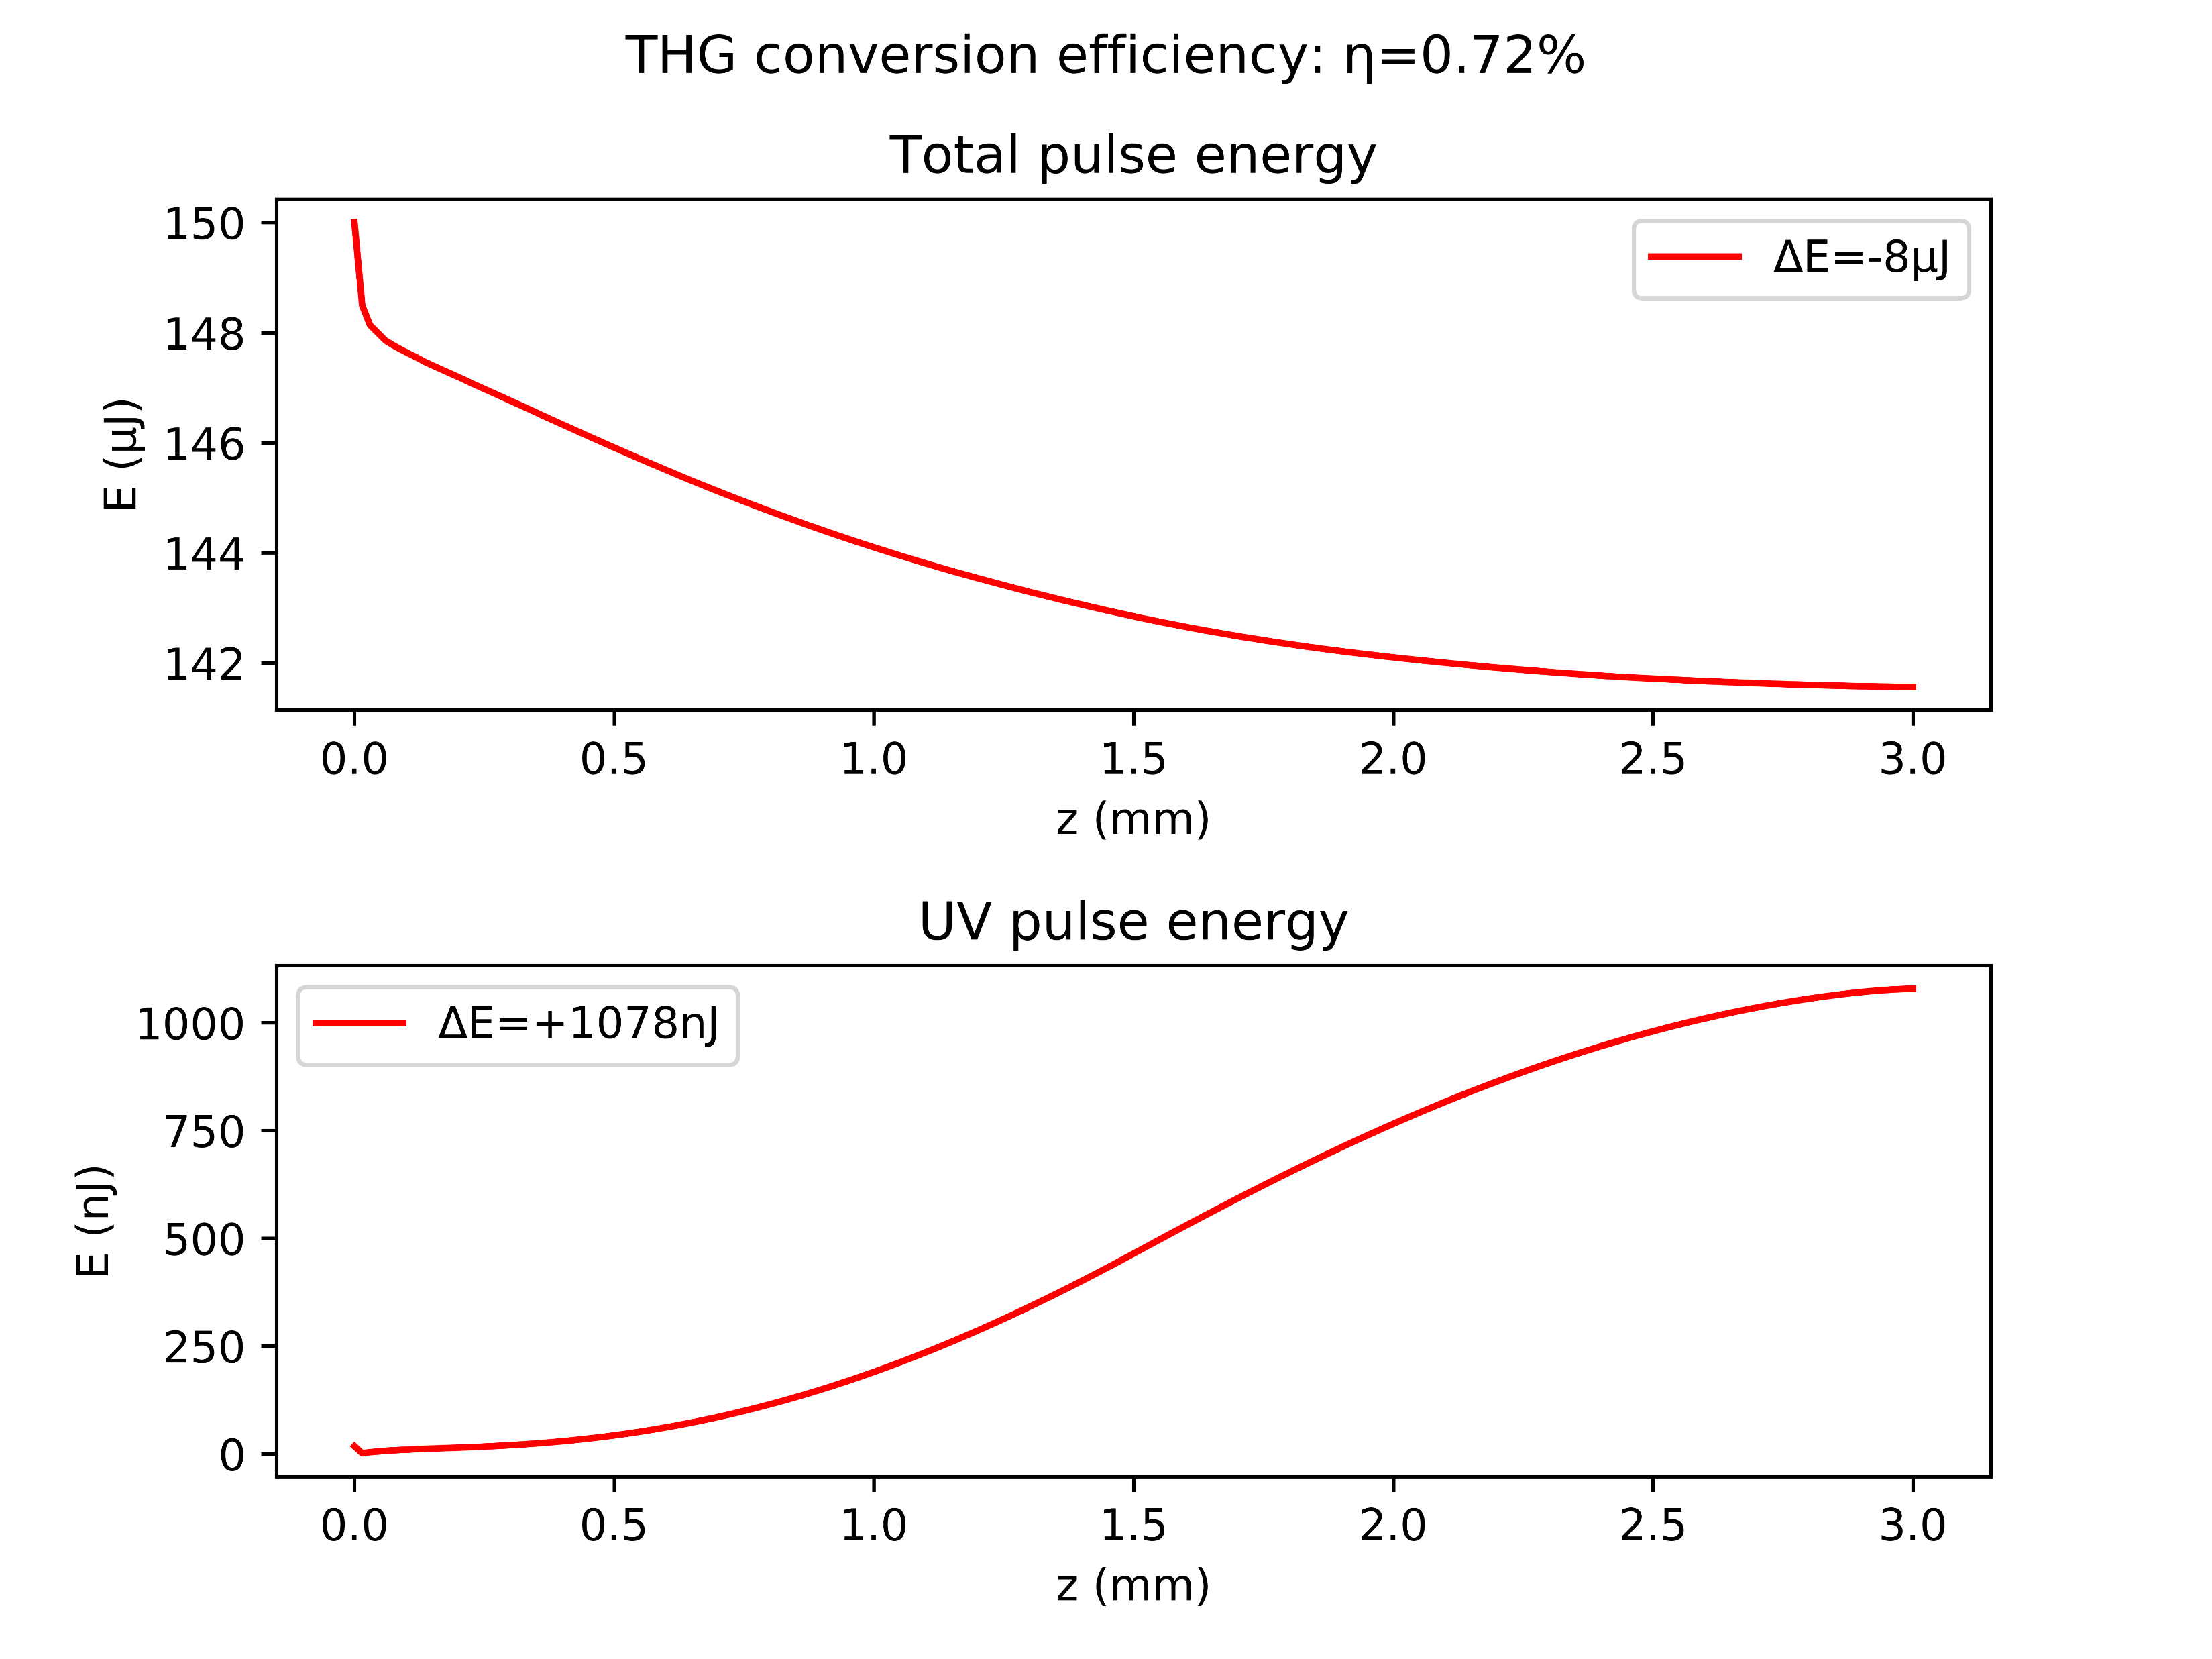
Position of beam focus
Shift by zr to the left
Centred focus
Shift by zr to the right

Slide 15
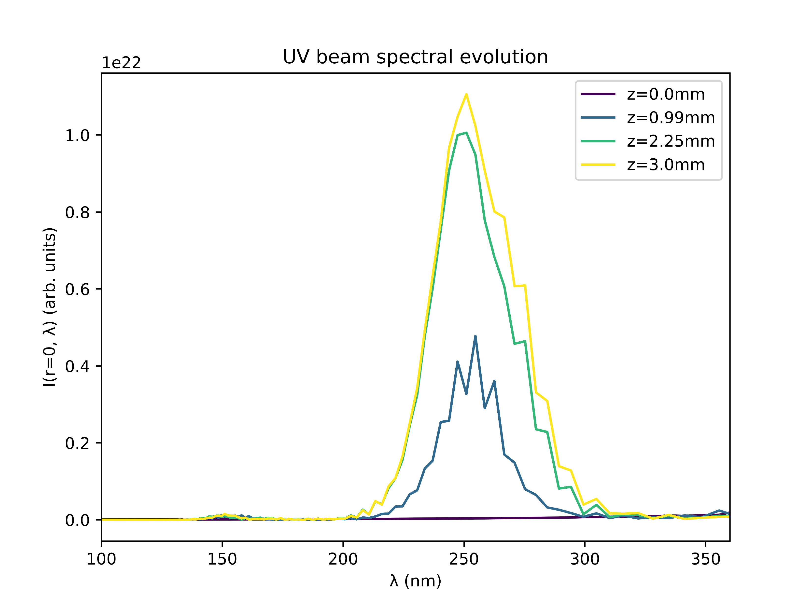
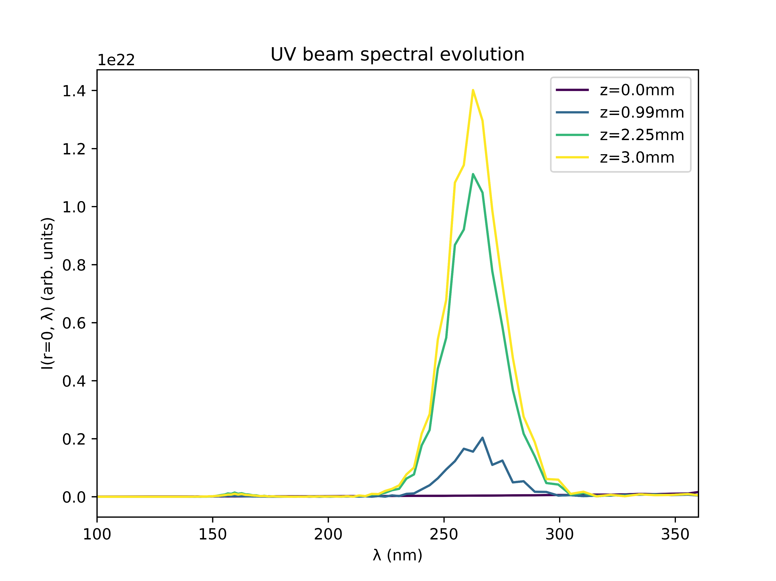
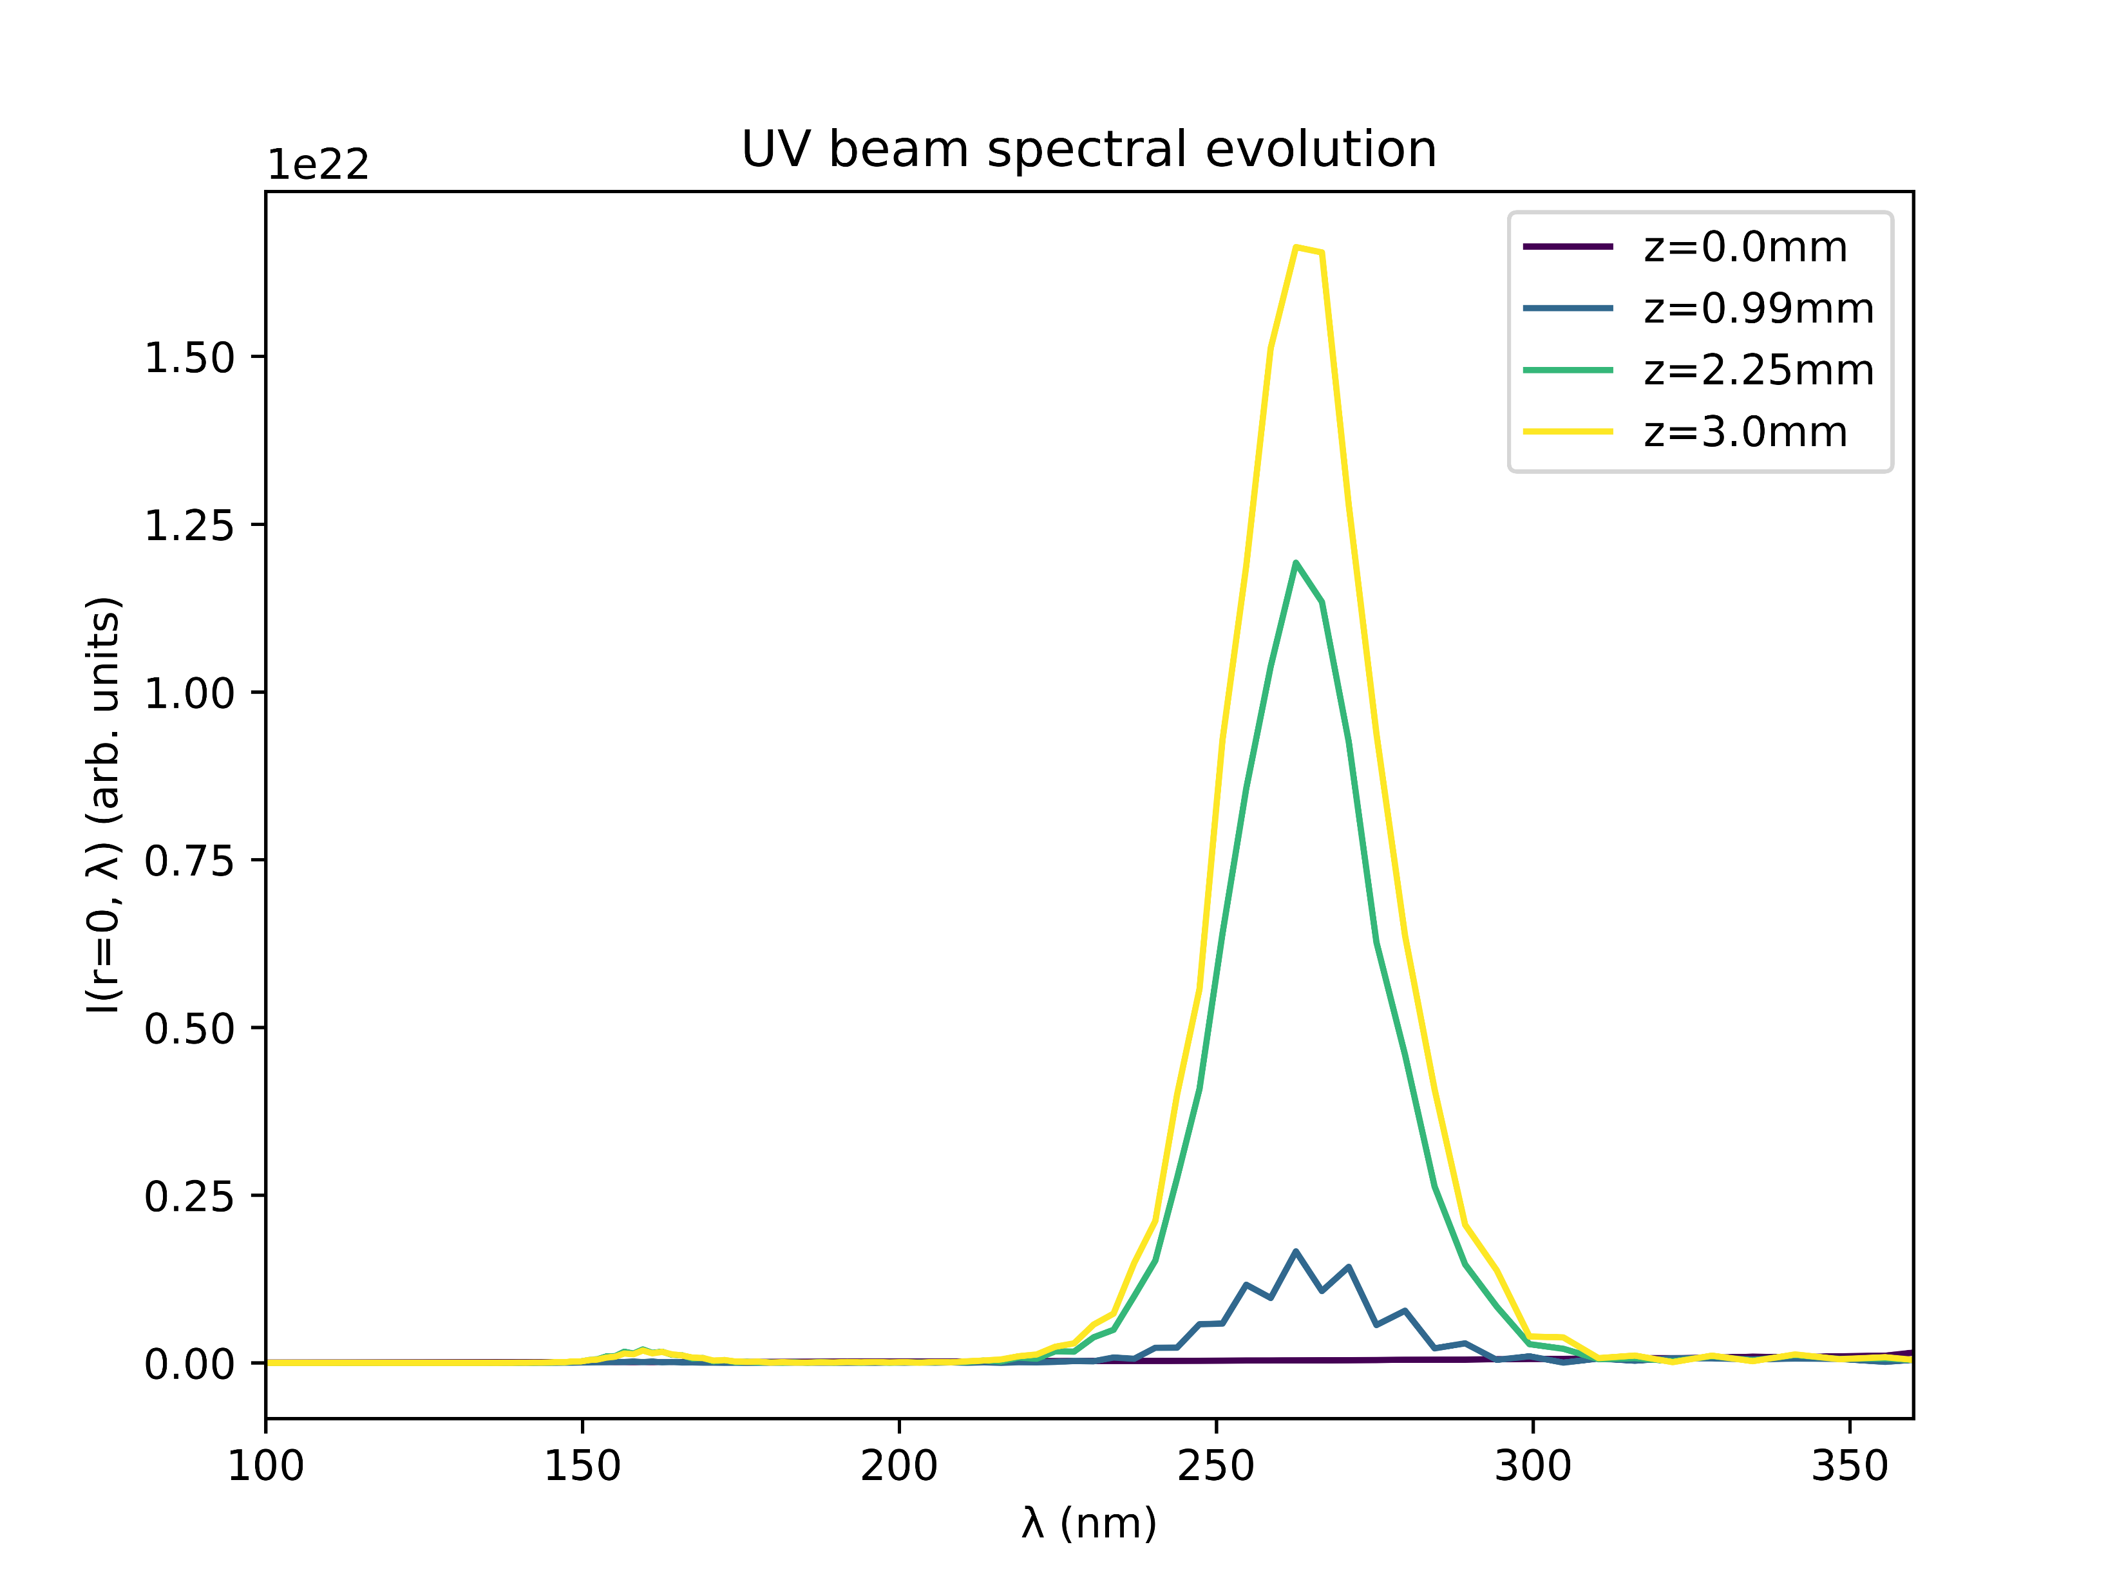
Position of beam focus
Shift by zr to the left
Centred focus
Shift by zr to the right

Slide 16
Next steps?
Check different gases
Use COMSOL density funcs
Re-do plots with experimental data overlayed

Slide 17
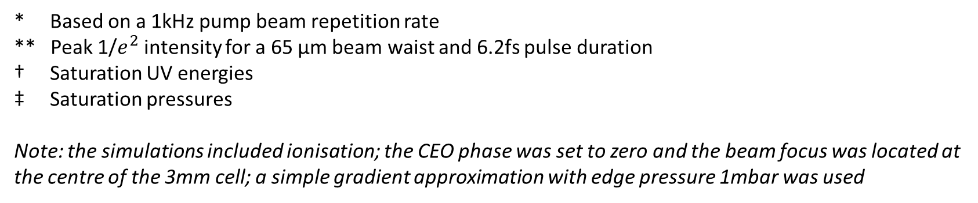
Relative Neon/Argon saturation values [OLD]
Beam power* | Beam peak intensity** | E_Ne/E_Ar † | P_Ne/P_Ar ‡
75mW | 0.091 PW/cm^2 | 0.945 | 11.591
150mW | 0.182 PW/cm^2 | 2.302 | 11.588
200mW | 0.243 PW/cm^2 | 2.871 | 10.688
300mW | 0.365 PW/cm^2 | 3.376 | 10.143
* Based on a 1kHz pump beam repetition rate
** Peak 1/$e^{2}$ intensity for a 65 µm beam waist and 6.2fs pulse duration
† Saturation UV energies
‡ Saturation pressures
Note: the simulations included ionisation; the CEO phase was set to zero and the beam focus was located at the centre of the 3mm cell; a simple gradient approximation with edge pressure 1mbar was used

Slide 18
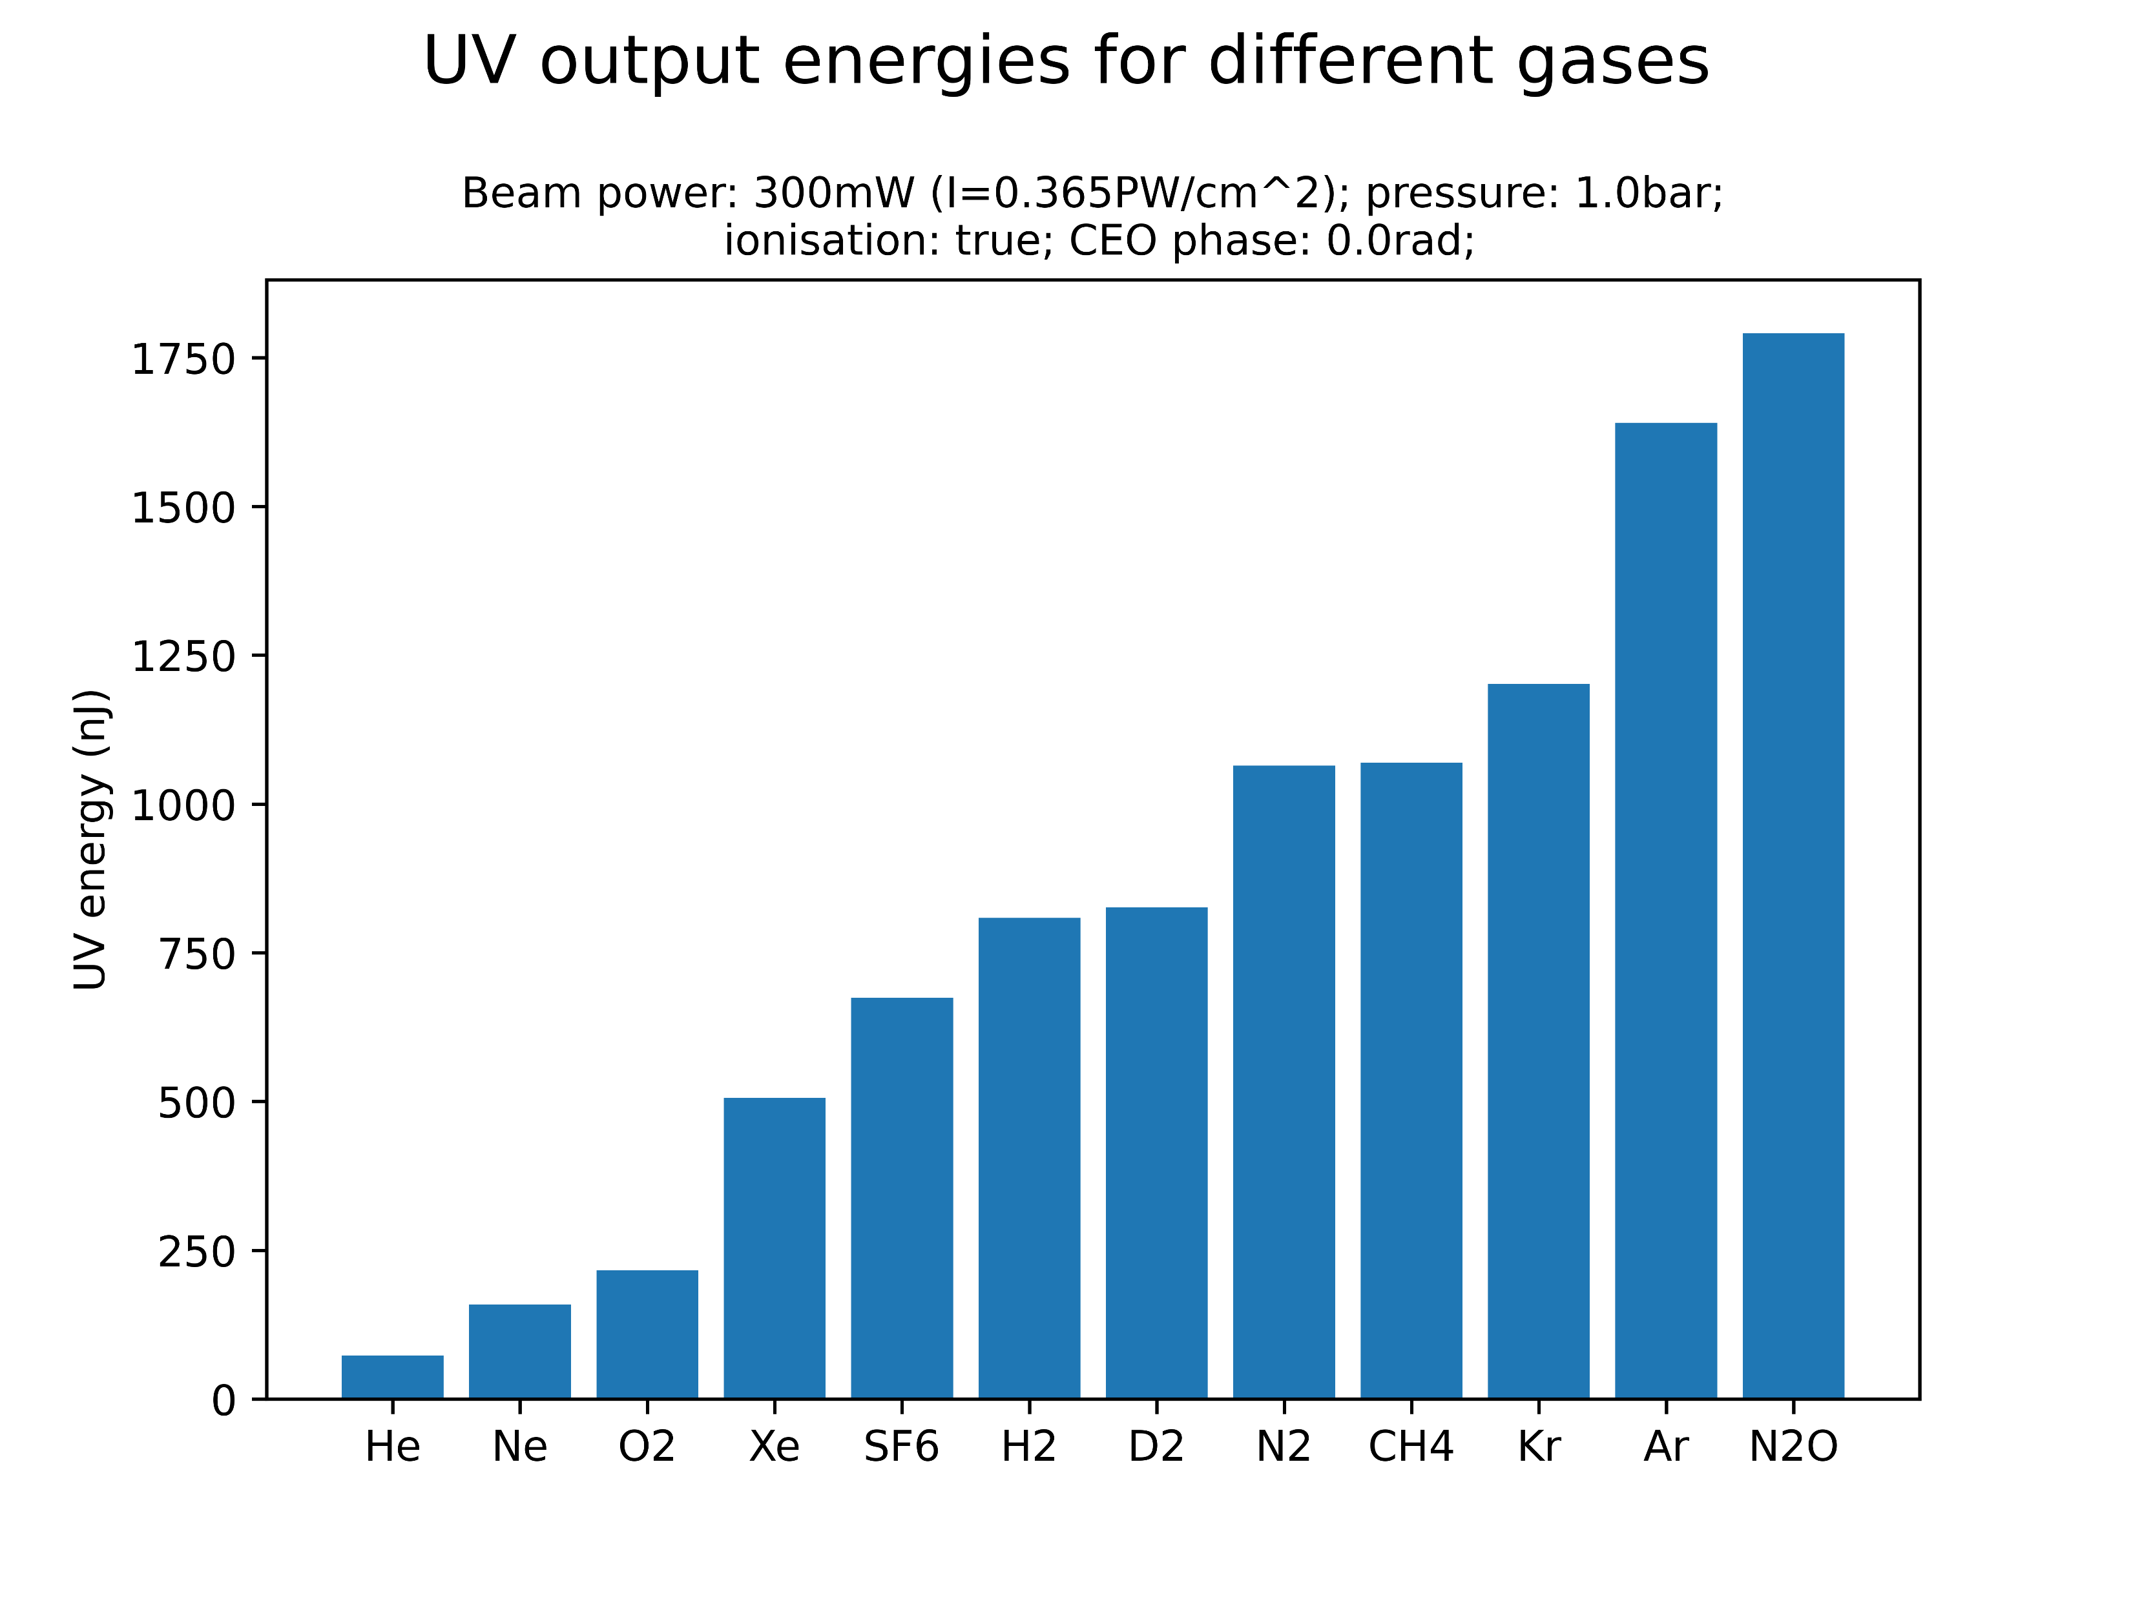
Comparison of different gases [OLD]
At the given parameter values, the highest UV energies are generated by krypton, argon and nitrous oxide
Investigate Kr and N2O in more detail (plots on Sync&Share)?
Neon, on the other hand, yields the second-lowest UV energy
Note that relative gas performance is likely sensitive to central gas pressure and beam power: simulations should be extended!

